Slide 1

Εισαγωγή στη Φυσική των Επιταχυντών
Δρ. Γιάννης ΠΑΠΑΦΙΛΙΠΠΟΥ
Τμήμα Δεσμών – Ομάδα Φυσικής Επιταχυντών CERN
ΑΡΙΣΤΟΤΕΛΕΙΟ ΠΑΝΕΠΙΣΤΗΜΙΟ ΘΕΣΣΑΛΟΝΙΚΗΣ
Μάθημα «Επιταχυντές και Ανιχνευτές»
Τμήμα Φυσικής
Αριστοτέλειο Πανεπιστήμιο Θεσσαλονίκης
Εαρινό εξάμηνο 2018

Slide 2
Longitudinal dynamics
RF acceleration
Energy gain and phase stability
Momentum compaction and transition
Equations of motion
  Small amplitudes
  Longitudinal invariant
Separatrix
Energy acceptance
Stationary bucket
Adiabatic damping

Slide 3
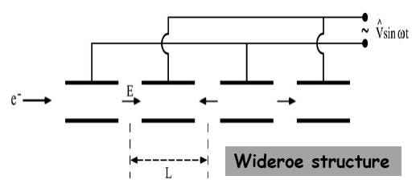
RF acceleration
The use of RF fields allows an arbitrary number of accelerating steps in gaps and electrodes fed by RF generator
The electric field is not longer continuous but sinusoidal alternating half periods of acceleration and deceleration
The synchronism condition for RF period T_{RF} and particle velocity v

Slide 4
Energy gain
Assuming a sinusoidal electric field where the synchronous particle passes at the middle of the gap g, at time t = 0, the energy is
And the energy gain is
and finally with the transit time
factor defined as
It can be shown that in general

Slide 5
Phase stability
Assume that a synchronicity condition is fulfilled at the phase φ_{s} and that energy increase produces a velocity increase
Around point P₁, that arrives earlier (N₁) experiences a smaller accelerating field and slows down
Particles arriving later (M1) will be accelerated more
A restoring force that keeps particles oscillating around a stable phase called the synchronous phase φ_{s}
The opposite happens around point P2 at π-φ_{s,} i.e. M2 and N2 will further separate

Slide 6
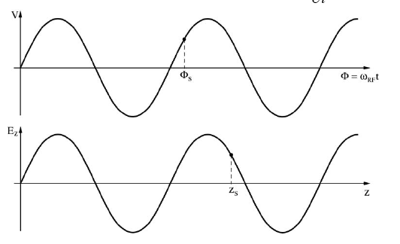
RF de-focusing
In order to have stability, the time derivative of the Voltage and the spatial derivative of the electric field should satisfy
In the absence of electric charge the divergence of the field is given by Maxwell’s equations
where x represents the generic transverse direction.
External focusing is required by using quadrupoles or solenoids

Slide 7
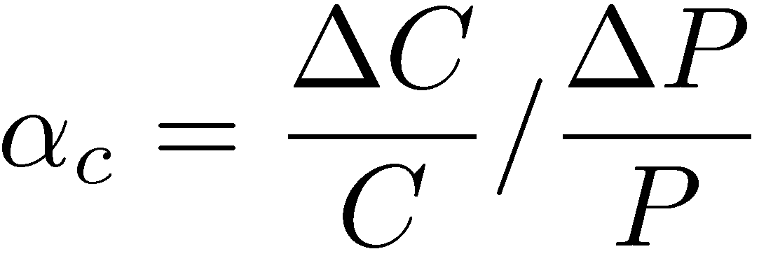
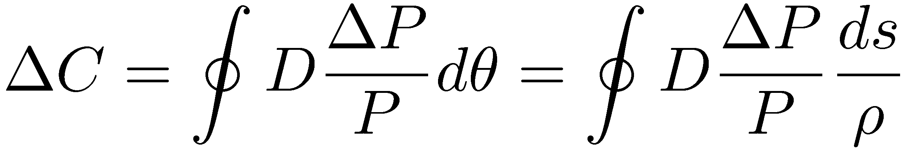
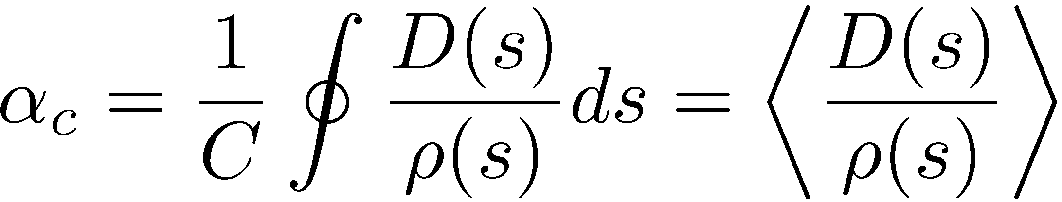
Momentum compaction
Off-momentum particles on the dispersion orbit travel in a different path length than on-momentum particles
The change of the path length with respect to the momentum spread is called momentum compaction
The change of circumference is
So the momentum compaction is
P+ΔP
D(s)ΔP/P
P
ρ
Δθ

Slide 8
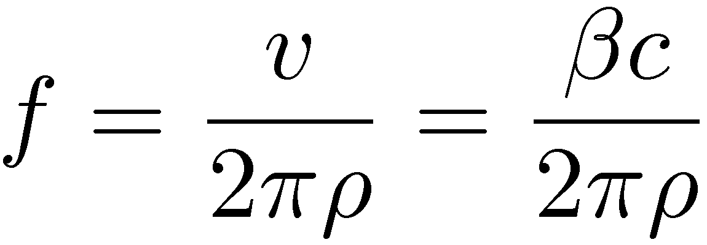
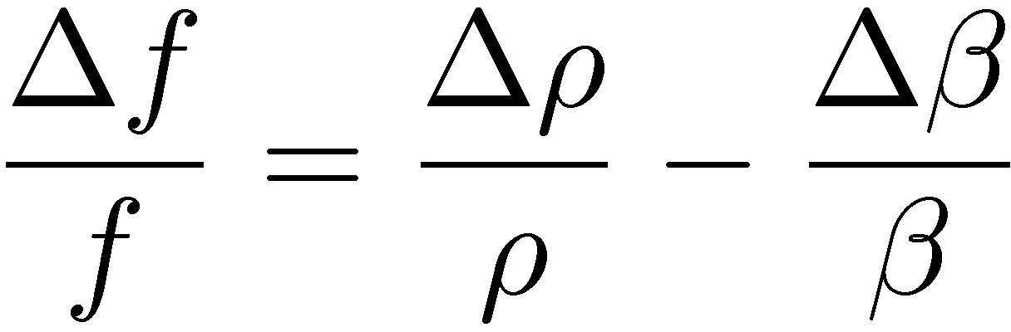

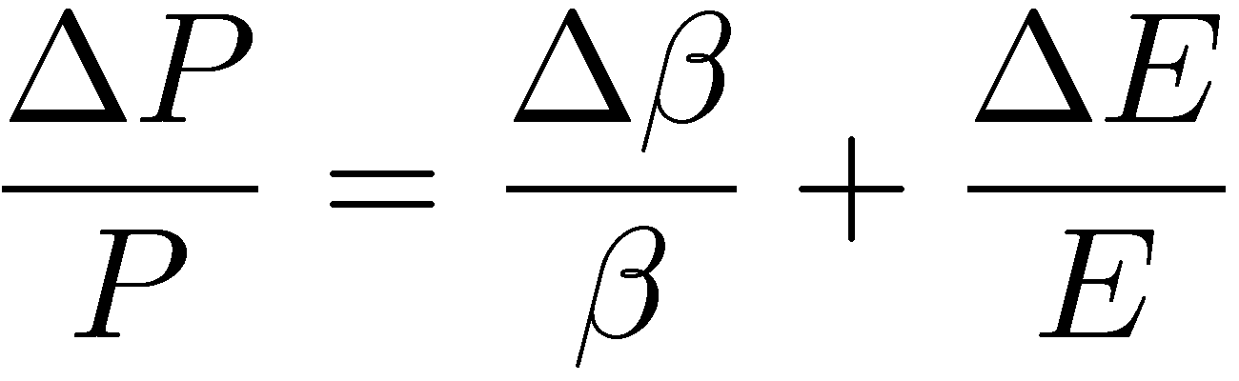
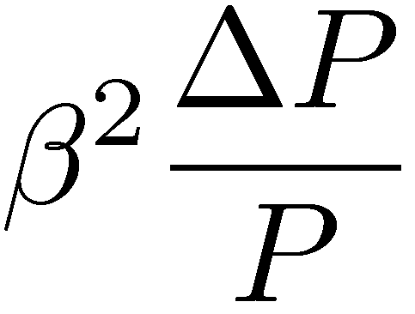
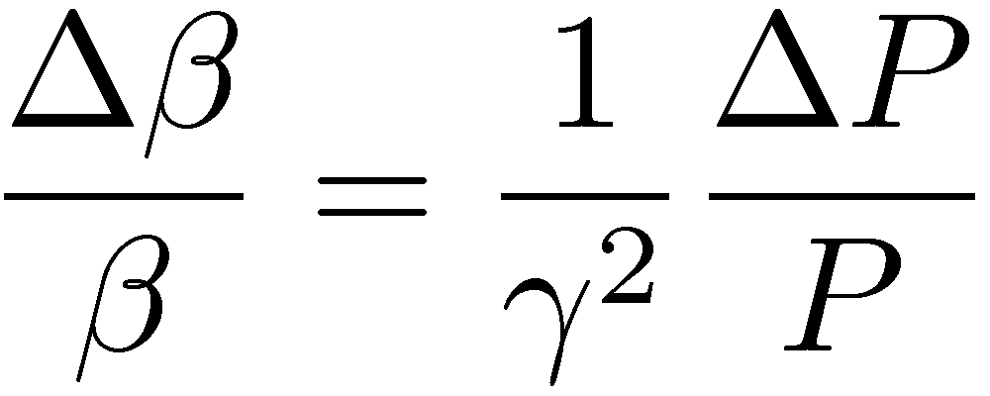
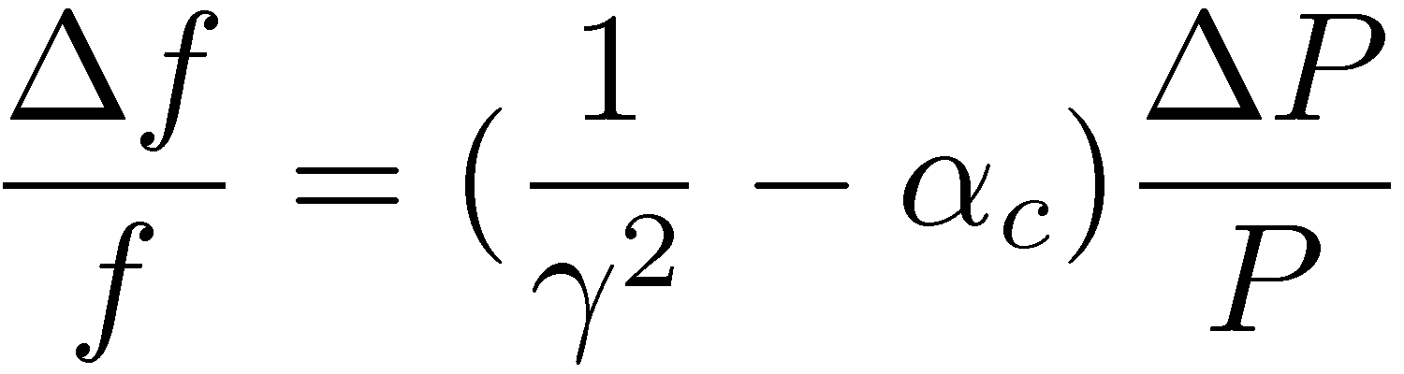
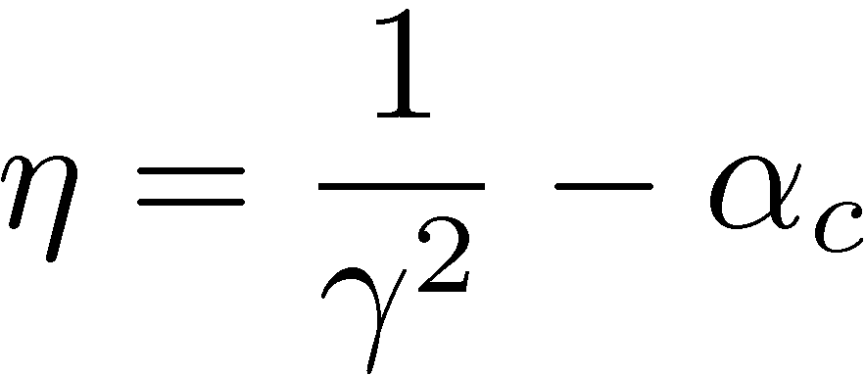
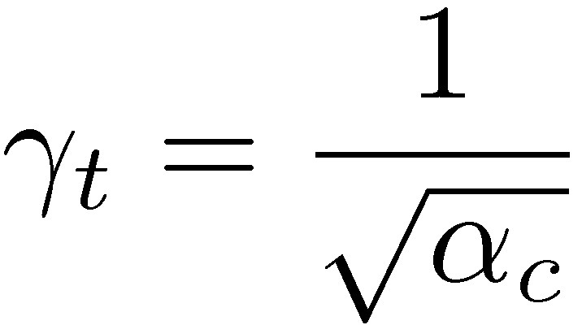
Transition energy
The revolution frequency of a particle is
The change in frequency is
From the relativistic momentum we have
for which
and the revolution frequency
The slippage factor is given by
For vanishing slippage factor,
the transition energy is defined

Slide 9
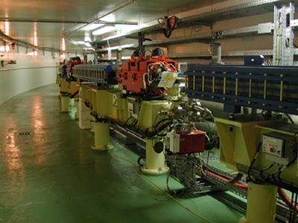
Synchrotron
Frequency modulated but also B-field increased synchronously to match energy and keep revolution radius constant.
The number of stable synchronous particles is equal to the harmonic number h. They are equally spaced along the circumference.
Each synchronous particle has the nominal energy and follow the nominal trajectory
Magnetic field increases with momentum and the per turn change of the momentum is
ESRF Booster

Slide 10
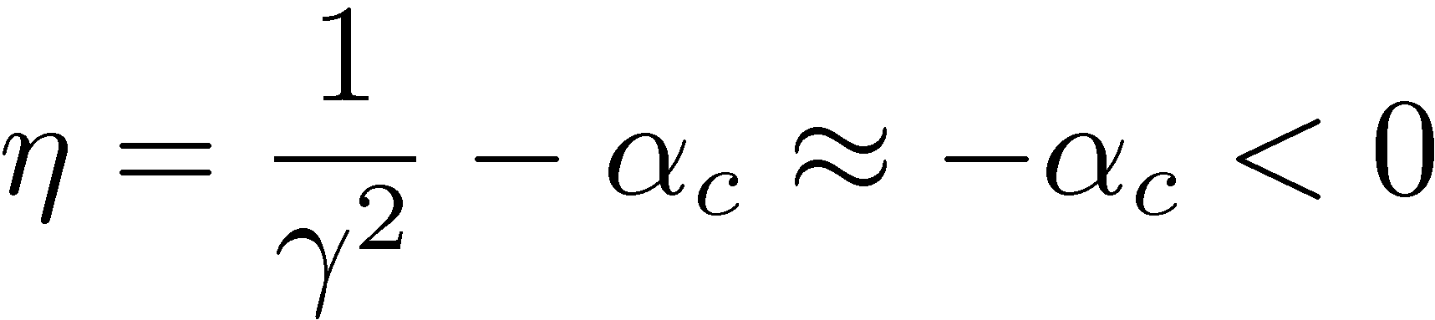
Phase stability on electron synchrotrons
For electron synchrotrons, the relativistic γ is very large and
as momentum compaction is positive in most cases
Above transition, an increase in energy is followed by lower revolution frequency
A delayed particle with respect to the synchronous one will get closer to it (gets a smaller energy increase) and phase stability occurs at the point P2 (π - φ_{s})

Slide 11
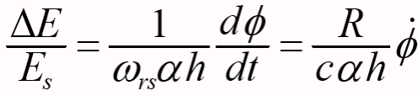
Energy and phase relation
The RF frequency and phase are related to the revolution ones as follows
and
From the definition of the momentum compaction and for electrons
c
Replacing the revolution frequency change, the following relation is obtained between the energy and the RF phase time derivative
c
c

Slide 12
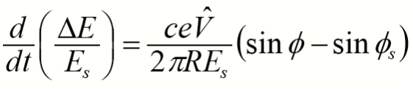
Longitudinal equations of motion
The energy gain per turn with respect to the energy gain of the synchronous particle is
The rate of energy change can be approximated by
The second energy phase relation is written as
By combining the two energy/phase relations, a 2nd order differential equation is obtained, similar the pendulum

Slide 13
Small amplitude oscillations
Expanding the harmonic functions in the vicinity of the synchronous phase
Considering also that the coefficient of the phase derivative does not change with time, the differential equation reduces to one describing an harmonic oscillator
with frequency
For stability, the square of the frequency should positive and real, which gives the same relation for phase stability when particles are above transition

Slide 14
Longitudinal motion invariant
For large amplitude oscillations the differential equation of the phase is written as
Multiplying by the time derivative of the phase and integrating, an invariant of motion is obtained
reducing to the following expression, for small amplitude oscillations

Slide 15
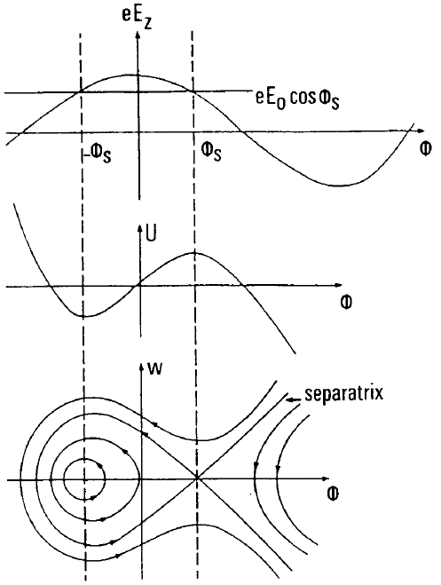
Separatrix
In the phase space (energy change versus phase), the motion is described by distorted circles in the vicinity of φ_{s} (stable fixed point)
For phases beyond π - φ_{s} (unstable fixed point) the motion is unbounded in the phase variable, as for the rotations of a pendulum
The curve passing through π - φ_{s} is called the separatrix and the enclosed area bucket

Slide 16
Energy acceptance
The time derivative of the RF phase (or the energy change) reaches a maximum (the second derivative is zero) at the synchronous phase
The equation of the separatrix at this point becomes
Replacing the time derivative of the phase from the first energy phase relation
This equation defines the energy acceptance which depends strongly on the choice of the synchronous phase. It plays an important role on injection matching and influences strongly the electron storage ring lifetime

Slide 17
Stationary bucket
When the synchronous phase is chosen to be equal to 0 (below
transition) or π (above transition),
there is no acceleration. The equation
of the separatrix is written
Using the (canonical) variable
and replacing the expression for the synchrotron frequency
. For φ= π, the bucket height is and the area

Slide 18
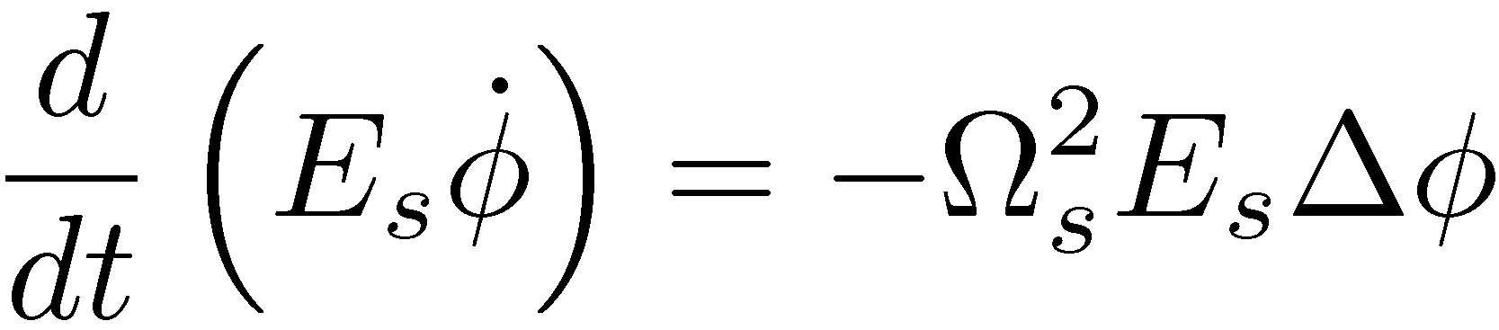
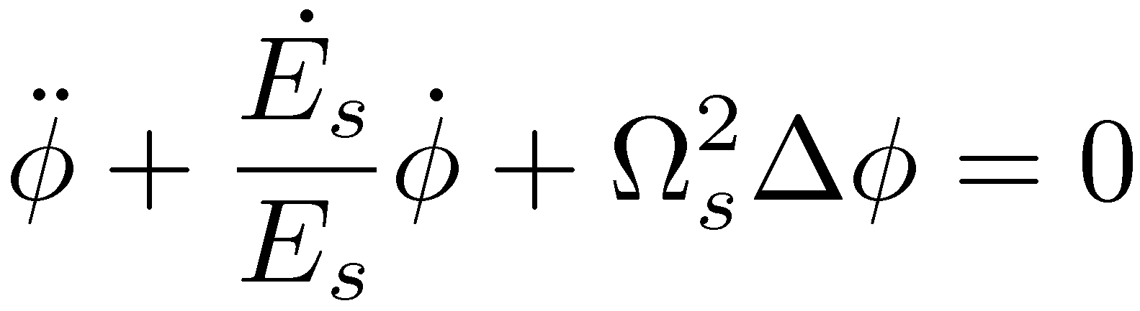
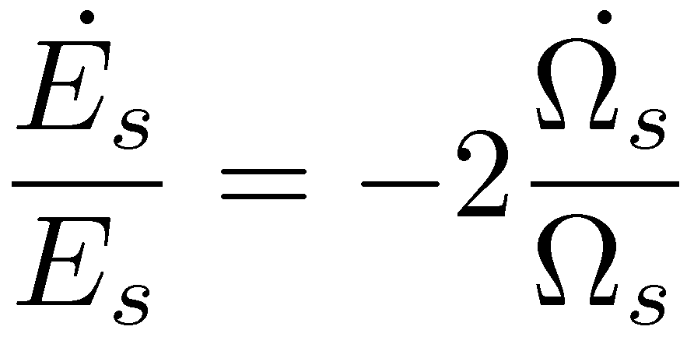
Adiabatic damping
The longitudinal oscillations can be damped directly by acceleration itself. Consider the equation of motion when the energy of the synchronous particle is not constant
From this equation, we obtain a 2nd order differential equation with a damping term
From the definition of the synchrotron frequency the damping coefficient is

Slide 19
Outline – Phase space concepts
Transverse phase space and Beam representation
Beam emittance
Liouville and normalised emittance
Beam matrix
RMS emittance
Betatron functions revisited
Gaussian distribution

Slide 20
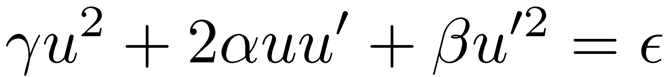
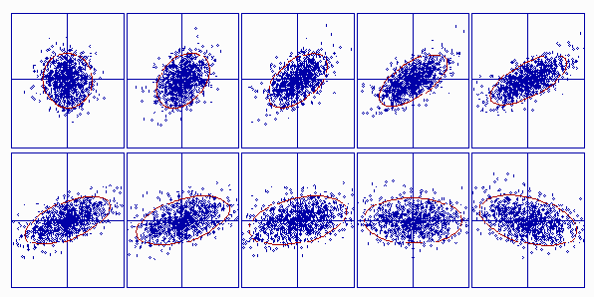
Transverse Phase Space
Under linear forces, any particle moves on ellipse in phase space (x,x’), (y,y’).
Ellipse rotates and moves between magnets, but its area is preserved.
The area of the ellipse defines the emittance
x´
x´
x
x
The equation of the ellipse is
with α,β,γ, the twiss parameters
Due to large number of particles, need of a statistical description of the beam, and its size

Slide 21
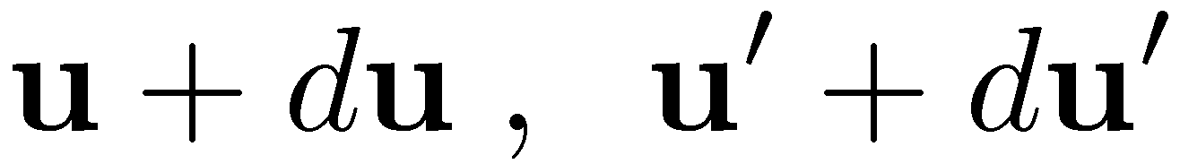
Beam representation
Beam is a set of millions/billions of particles (N)
A macro-particle representation models beam as a set of n particles with n<<N
Distribution function is a statistical function representing the number of particles in phase space between

Slide 22
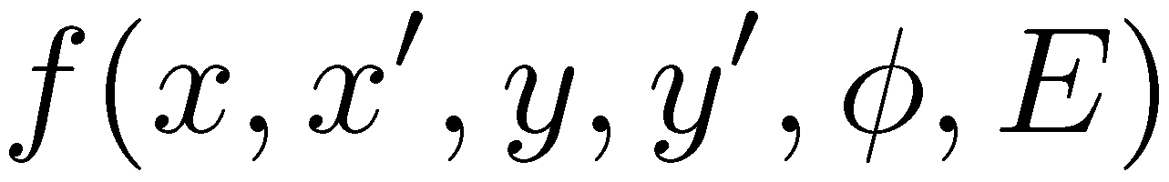
Liouville emittance
Emittance represents the phase-space volume occupied by the beam
The phase space can have different dimensions
  2D (x, x’) or (y, y’) or (φ, Ε)
  4D (x, x’,y, y’) or (x, x’, φ, Ε) or (y, y’, φ, Ε)
  6D (x, x’, y, y’, φ, Ε)
The resolution of my beam observation is very large compared to the average distance between particles.
The beam modeled by phase space distribution function
The volume of this function on phase space is the beam Liouville emittance

Slide 23
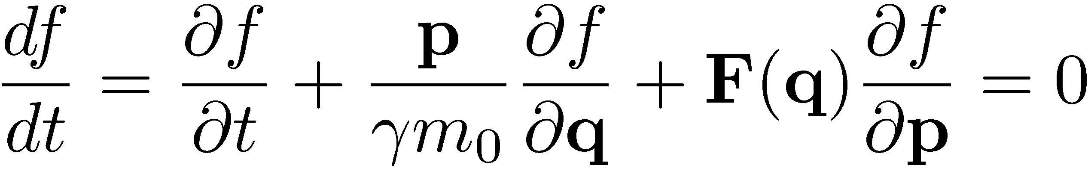
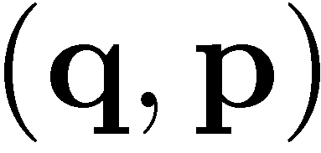
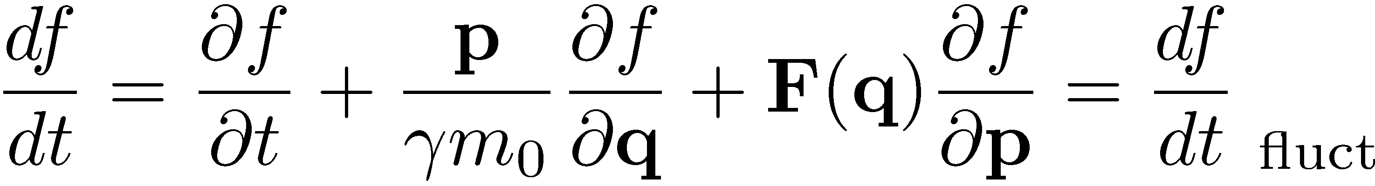
Vlasov and Boltzmann equations
The evolution of the distribution function is described by Vlasov equation
Mathematical representation of Liouville theorem stating the conservation of phase space volume
In the presence of fluctuations (radiation, collisions, etc.) distribution function evolution described by Boltzmann equation
The distribution evolves towards a Maxwell-Boltzmann statistical equilibrium

Slide 24
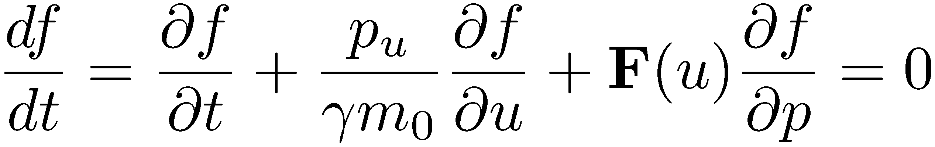
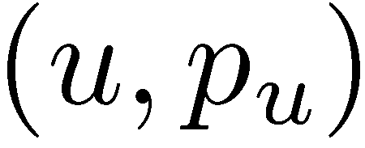
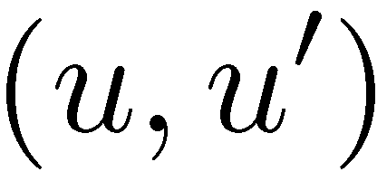
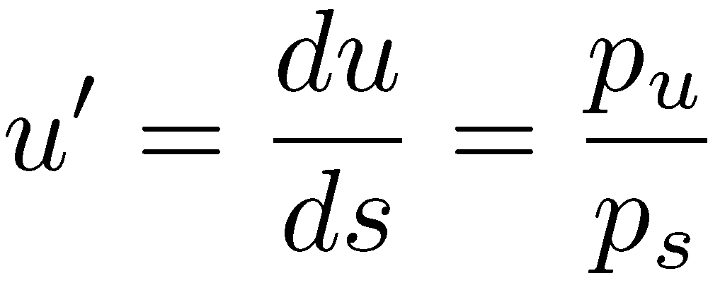
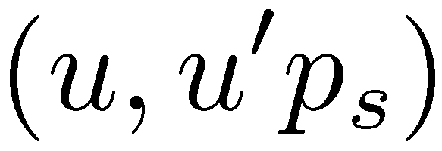
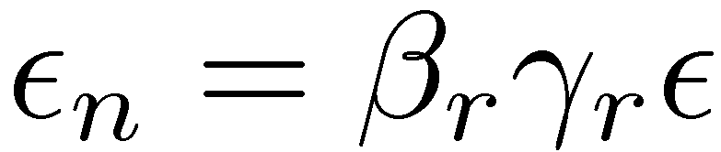
2D and normalized emittance
When motion is uncoupled, Vlasov equation still holds for each plane individually
The Liouville emittance in the 2D phase space is still conserved
In the case of acceleration, the emittance is conserved in the but not in the (adiabatic damping)
Considering that
the beam is conserved in the phase space
Define a normalised emittance which is conserved during acceleration

Slide 25
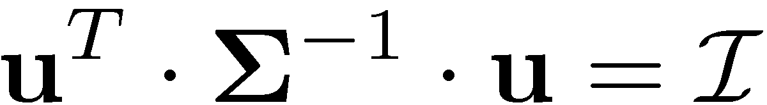
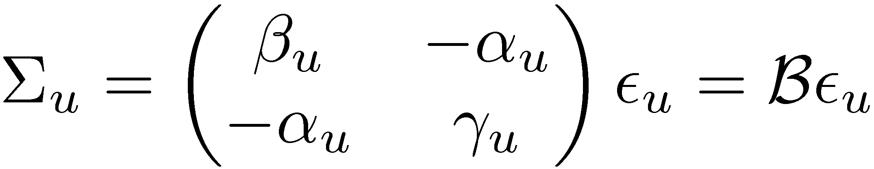
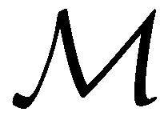
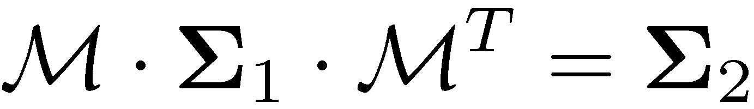
Beam matrix
We would like to determine the transformation of the beam enclosed by an ellipse through the accelerator
Consider a vector u = (x,x’,y,y’,…) in a generalized n-dimensional phase space. In that case the ellipse transformation is
Application to one dimension gives
and comparing with
provides the beam matrix
which can be expanded to more dimensions
Evolution of the n-dimensional phase space from position 1 to position 2, through transport matrix

Slide 26
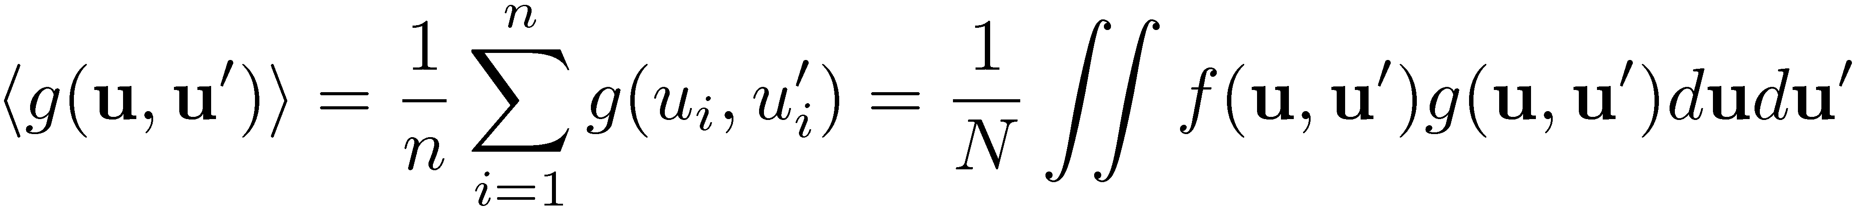
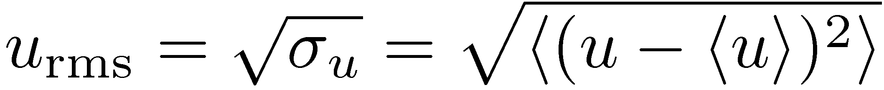
Root Mean Square (RMS) beam parameters
The average of a function on the beam distribution defined
Taking the square root, the following Root Mean Square (RMS) quantities are defined
  RMS beam size
  RMS beam divergence
  RMS coupling

Slide 27
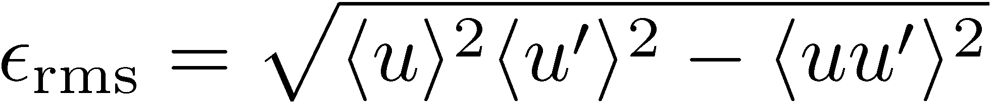

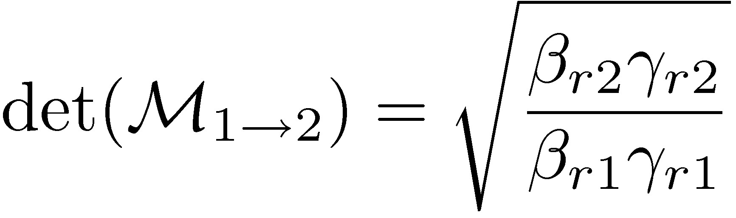
RMS emittance
Beam modelled as macro-particles
Involved in processed linked to the statistical size
The rms emittance is defined as
It is a statistical quantity giving information about the minimum beam size
For linear forces the rms emittance is conserved in the case of linear forces
The determinant of the rms beam matrix
Including acceleration, the determinant of 6D transport matrices is not equal to 1 but

Slide 28
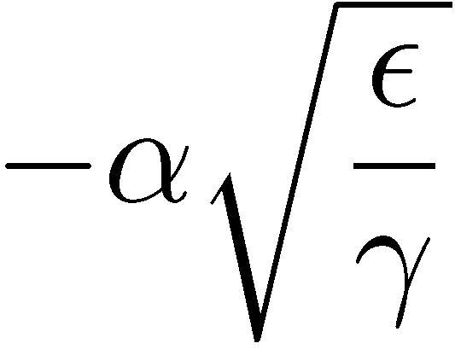
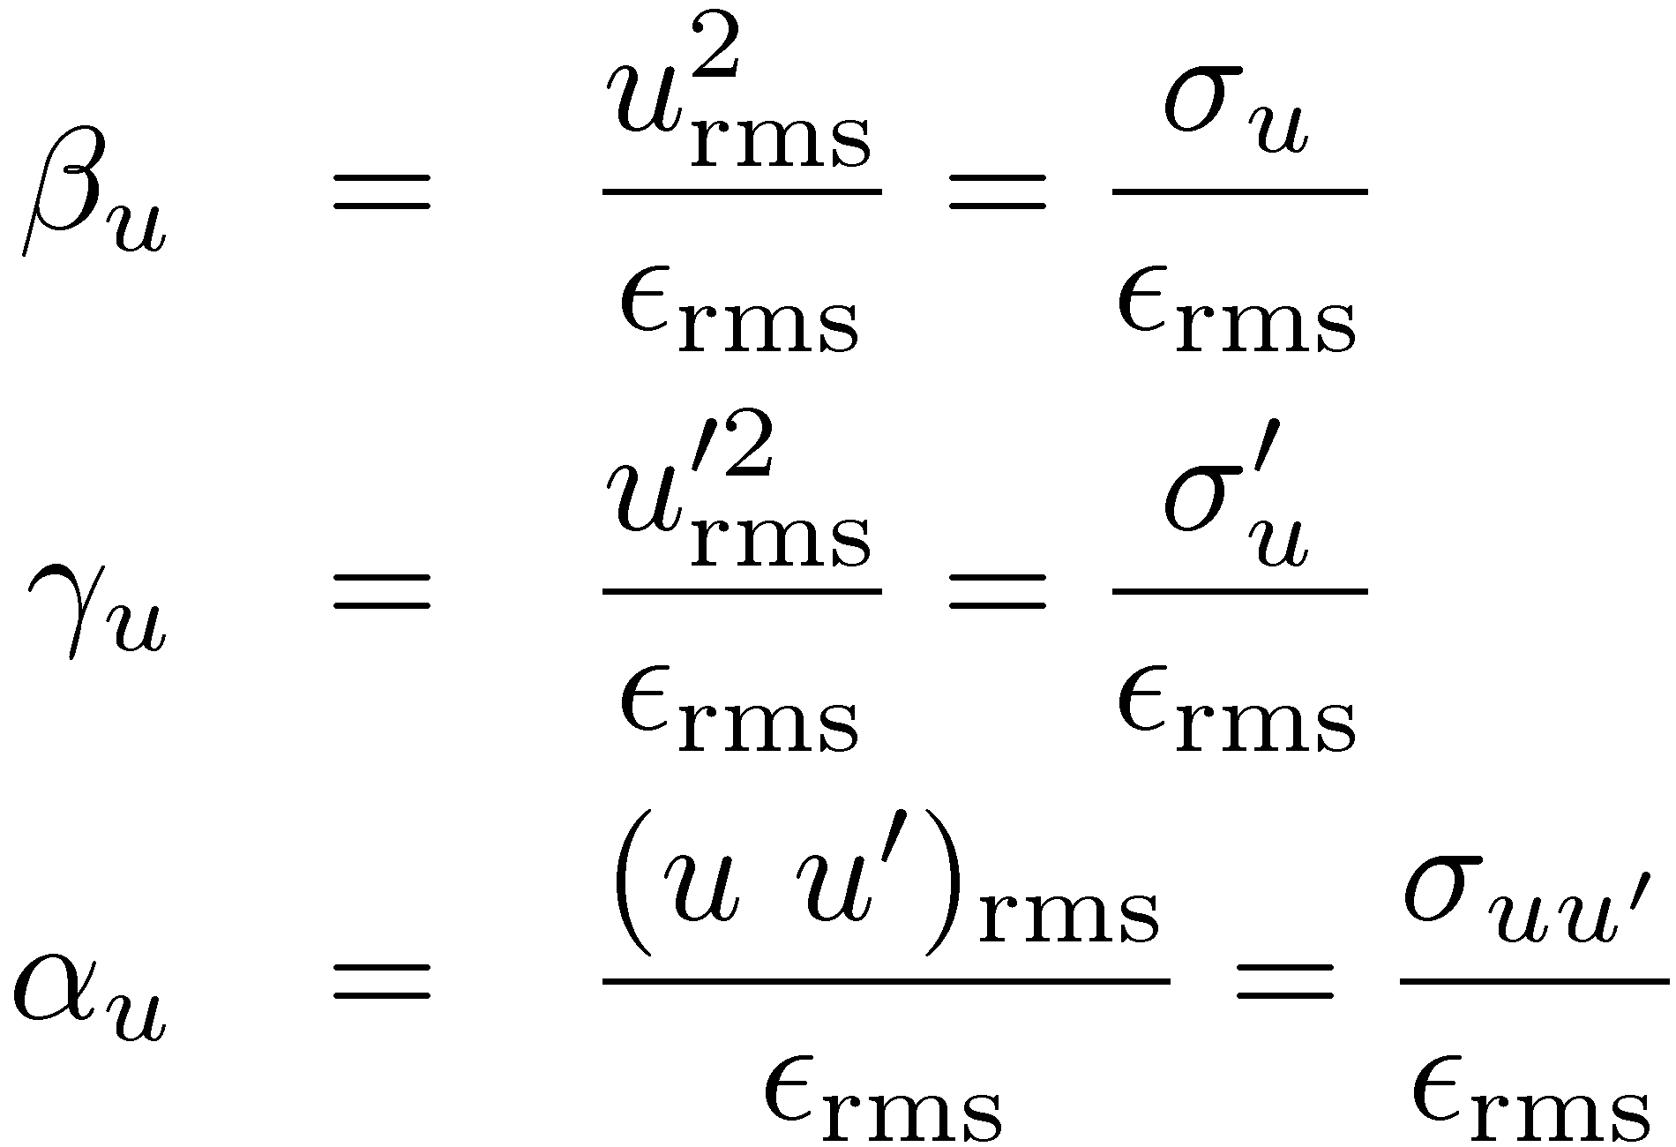
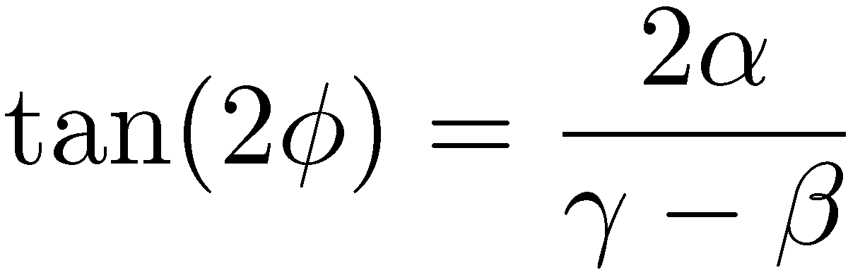
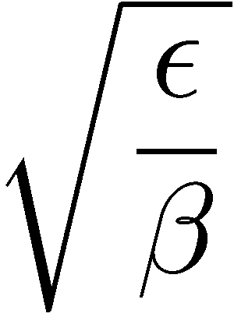
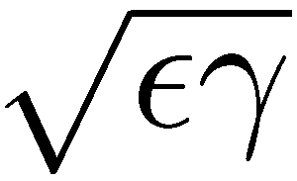
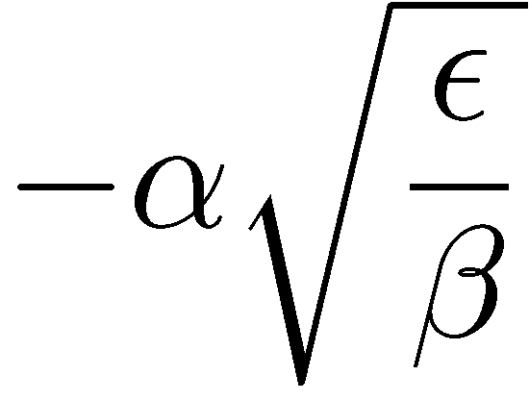

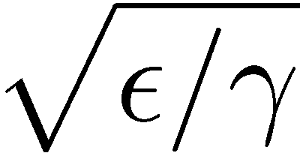

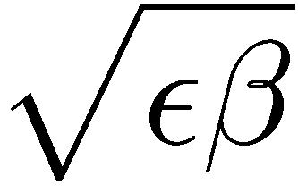
Beam betatron functions
The best ellipse fitting the beam distribution is
The beam betatron functions can be defined through the rms emittance

Slide 29



Gaussian distribution
The Gaussian distribution has a gaussian density profile in phase space
  for which
  The beam boundary is
  Uniform (KV) Gaussian

Slide 30
Outline
Radiation damping
  Synchrotron oscillations
  Betatron oscillations
  Robinson theorem
Radiation integrals
Quantum excitation
Equilibrium emittances

Slide 31
Synchrotron Radiation and Radiation Damping
Up to this point, the transport of a relativistic particle around a ring was treated as a conservative process
The particle change of momentum (acceleration) results in emission of synchrotron radiation
It turns out that this is much more important in circular then linear accelerators
The emission of synchrotron radiation results in energy lost by the particle and the damping of oscillations, called radiation damping
This energy lost is recovered by the RF accelerating cavities in the longitudinal direction but not in the transverse

Slide 32







Why circular machines?
Larmor Power radiated by non-relativistic particles is very small
Power radiated by relativistic particles in linear accelerators is negligible
Power radiated by relativistic particles in circular accelerators is very strong (Liénard, 1898)

Slide 33

Lienard’s Paper
“Electric and Magnetic Field produced by an electric charge concentrated at a point and travelling on an arbitrary path”
Prophetically published in the french journal “The Electric Light”

Slide 34

Why electrons?
Power inversely proportional to 4th power of rest mass (proton 2000 times heavier than electron)
On the other hand, for multi TeV hadron colliders (LHC, FCCpp) synchrotron radiation is an important issue (protection with beam screens)
By integrating around one revolution, the energy loss per turn is obtained. For the ILC DR, it is around 4.5 MeV/turn. On the other hand, for LEPII (120 GeV) it was 6 GeV/turn, or for FCCee (ttbar flavor at 175 GeV), it will be 7.5GeV/turn i.e. circular electron/positron machines of hundreds of GeV become quite demanding with respect to RF power (and extremely long)

Slide 35
Synchrotron Radiation formulas for e⁻/e⁺
The power radiated by a relativistic electron can be rewritten as
with
The energy loss per turn can be expressed as
with the 2nd radiation integral
For a lattice with uniform bending radius (iso-magnetic) this yields
If this energy were not recovered, particles would gradually spiral inward until lost on vacuum chamber wall
RF cavities replace this lost energy by providing momentum kicks to the beam in the longitudinal direction

Slide 36

Damping of synchrotron oscillations
Consider the differential equation of the energy for longitudinal motion
with damping coefficient
where is the energy requirement per turn of the particle, and the revolution period and the synchrotron frequency
The solution can be written as a damped oscillation in energy and time with respect to the ideal synchromous particle

Slide 37



Damping of synchrotron oscillations
  Note that the synchrotron motion is damped towards the motion of the synchronous particle
The damping coefficient is dependent on the energy of the particle through the radiated power but also through the revolution period. In the following, we try to establish this relationship
A particle with energy spread follows a dispersive trajectory with dispersion D
The energy requirement per turn can be obtained by the integral of the radiated power in one revolution
Differentiating with respect to the energy

Slide 38






Damping of synchrotron oscillations II
Taking into account that the average energy spread around the ring should be zero the previous integral is written:
Setting and taking into account the
definition of the magnetic rigidity, the expression of the radiation power is written
Its derivative with respect to the energy gives
where we used the identity
Replacing in the integral at the top,

Slide 39




Damping of synchrotron oscillations III
Replacing in the last integral the expression of the power
and taking into account that
the damping of synchrotron motion is written
with the damping partition number defined as
This is a parameters entirely defined by the lattice!
Bending magnets and quads are usually separated and the damping partition number is usually extremely small

Slide 40


Damping of vertical oscillations
Synchrotron radiation emitted in the direction of motion of electron, whose momentum is reduced
This reduces the vertical component of the momentum but the angle remains the same
The key for betatron damping is the energy recovery by the RF cavities, as only the longitudinal momentum is restored
The change in energy will not affect the vertical position but the angle changes proportionally
γ
RF Cavity
E

Slide 41







Damping of vertical oscillations II
Recall now solution of Hill’s equations in the vertical plane, assuming that the beta function is slowly varying (i.e. alpha function is zero), for simplicity
The betatron oscillation amplitude is
The change of the amplitude becomes
By averaging over all angles
and
Summing up the energy losses for a full turn
Thus, in one turn the amplitudes are damped with a constant

Slide 42
Damping of vertical oscillations II
The vertical betatron amplitude is thus exponentially decaying
Equivalently, the damping of the vertical emittance is given by
This means that the vertical emittance in the absence of dispersion or coupling will be reduced to zero
Actually, due to the fact that the radiation emission is not parallel to the motion (but in an angular distribution with a width of ~1/γ), there is a “recoil” preventing vertical oscillations to be reduced to zero
This gives a “quantum limit”, beyond which the vertical emittance cannot be further reduced

Slide 43





Damping of horizontal oscillations
The horizontal motion is described by
Energy change due to photon emission results in a change of the dispersive part but not of the total coordinates so that
The change of the Betatron amplitude
becomes
The energy loss in an element dl is written
Substituting to the change in amplitude and averaging over the angles (and some patience…)
and the damping coefficient

Slide 44





Robinson theorem
Grouping the damping constants and introducing the three damping times and damping partition numbers
The Robinson theorem (1958) states that the sum of the damping partition number is an invariant
In storage ring with separated function magnets, and
The longitudinal damping occurs at twice the rate of the damping in the two transverse dimensions

Slide 45
Transverse emittances
Radiation damping provides a direct mechanism to take “hot” injected beams and reduce the equilibrium parameters to a regime useful for high luminosity colliders and high brightness light sources.
At the same time, the radiated power plays a dominant role in the design of the associated hardware and its protection
If the only effect was radiation damping, the transverse emittances would be damped to zero.
Photons are emitted in energy bursts in localized areas and horizontal betatron oscillations are excited as well (quantum fluctuations)
Vertical emittance can become very small and only excited by coupling with the horizontal or residual vertical dispersion
Electrons are influenced by this stochastic effect and eventually loose memory (unlike hadrons)

Slide 46
Equilibrium Beam Properties
The emission of photons by the beam is a random process around the ring
Photons are emitted within a cone around the direction of the beam particle with a characteristic angle 1/γ
This quantized process excites oscillations in each dimension
In the absence of resonance or collective effects, which also serve to heat the beam, the balance between quantum excitation and radiation damping results in the equilibrium beam properties that are characteristics of a given ring lattice

Slide 47
Quantum Excitation - Longitudinal
For the very short timescales corresponding to photon emission, we can take the equations of motion we previously obtained for synchrotron motion and write:
where A_{E} is a constant of the motion.
The change in A_{E} due to the emission of photons should be estimated
The emission of an individual photon will not affect the time variable, however, it will cause an instantaneous change in the value of ΔΕ

Slide 48
Quantum Excitation - Longitudinal
From the solution of the synchrotron equation of motion, the energy difference is
where u is the energy radiated at time t₁. Thus, for t=t₁
and
Considering the rate of photon emission N , the average change in synchrotron amplitude due to photon emission is

Slide 49
Quantum Excitation - Longitudinal
By including, the radiation damping term, the net change in the synchrotron amplitude can be written as:
The equilibrium properties of a bunch are obtained when the rate of growth from quantum excitation and the rate of damping from radiation damping are equal
For an ensemble of particles where the rms energy amplitude is represented by the rms energy spread, the equilibrium condition are written as

Slide 50
Photon Emission
The term is the ring-wide average of the photon emission rate, N, times the mean square energy loss associated with each emission
where n(u) is the photon emission rate at energy u,
with C is the ring circumference.
The derivation of the photon spectrum emitted in a magnetic field is quite lengthy and we just quote the result

Slide 51
Energy Spread and Bunch Length
Integrating around the ring then yields the RMS beam energy spread
Using this expression with the synchrotron equations of motion, the bunch length is related to the energy spread by
, with the harmonic number
The bunch length scales inversely with the square root of the RF voltage.

Slide 52







Quantum excitation - horizontal
photon emission
Assume electron along nominal momentum orbit with initially negligible emittance
After photon emission with momentum Δp, electron’s momentum becomes p₀-Δp and the trajectory becomes
and

Slide 53
Dispersion emittance
Recall that the emittance of the betatron ellipse in phase space is
Taking into account the change of the position and angle due to the photon emission, the change of the emittance is
with the “dispersion” emittance (or curly H-function)

Slide 54



Horizontal equilibrium emittance
Averaging over all photon energies and emission probabilities, the equilibrium emittance is derived as
, with
For isomagnetic ring with separated function magnets the equilibrium emittance is written
The integral depends on the optics functions on the bends
It gets small for small horizontal beta and dispersion, but this necessitates strong quadrupoles
Smaller bending angle and lower energy reduce equilibrium emittance

Slide 55
Quantum Excitation - Vertical
In the vertical dimension, assuming an ideal ring with no vertical dispersion, the quantum excitation of the emittance is determined by the opening angle of the emitted photons. The resulting perturbation to the vertical motion can be described as:
and the effect to the emittance is
Averaging over all photon energies and emission probabilities, the quantum limit of the vertical emittance is derived as

Slide 56
Vertical Emittance & Emittance Coupling
For typical storage ring parameters, the vertical emittance due to quantum excitation is very small
Assuming a typical β_{y} values of a few 10’s of meters and bending radius of ~100 m, the quantum limit is ε_{y} ~ 0.1 pm.
The observed sources of vertical emittance are:
  emittance coupling whose source is ring errors which couple the vertical and horizontal betatron motion
  vertical dispersion due to vertical misalignment of the quadrupoles and sextupoles and angular errors in the dipoles
The vertical and horizontal emittances in the presence of a collection of such errors around a storage ring is commonly described as:
ε₀ is the horizontal equilibrium (natural) emittance.

Slide 57










Radiation integrals
Momentum compaction factor
Energy loss per turn
Equilibrium energy spread
Damping partition numbers
Equilibrium betatron emittance

