Slide 1

Εισαγωγή στη Φυσική των Επιταχυντών
Δρ. Γιάννης ΠΑΠΑΦΙΛΙΠΠΟΥ
Τμήμα Δεσμών – Ομάδα Φυσικής Επιταχυντών CERN
ΑΡΙΣΤΟΤΕΛΕΙΟ ΠΑΝΕΠΙΣΤΗΜΙΟ ΘΕΣΣΑΛΟΝΙΚΗΣ
Μάθημα «Επιταχυντές και Ανιχνευτές»
Τμήμα Φυσικής
Αριστοτέλειο Πανεπιστήμιο Θεσσαλονίκης
Εαρινό εξάμηνο 2018

Slide 2
References
J. Rossbach and P. Schmuser, Basic course on accelerator optics, CERN Accelerator School, 1992.
H. Wiedemann, Particle Accelerator Physics I, Springer, 1999.
K. Wille, The physics of Particle Accelerators, Oxford University Press, 2000.

Slide 3
Outline - part I
Coordinate system
Equations of motion
Hill’s equations
  Derivation
  Harmonic oscillator
Transport Matrices
  Matrix formalism
  Drift
  Thin lens
  Quadrupoles
  Dipoles
    Sector magnets
    Rectangular magnets
  Doublet
  FODO

Slide 4
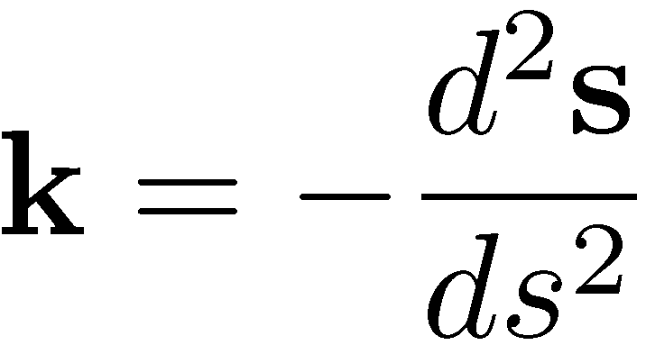
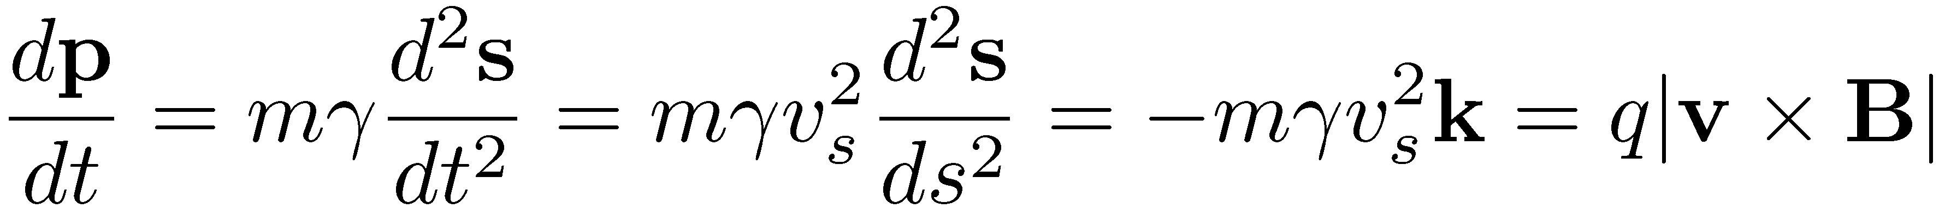
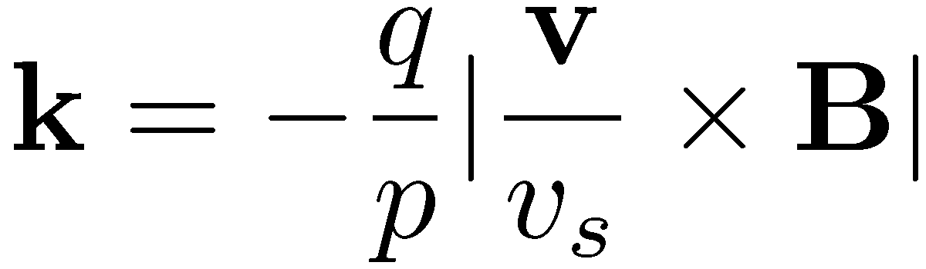
Coordinate system
Cartesian coordinates not useful to describe motion in an accelerator
Instead we use a system following an ideal path along the accelerator
The ideal path is defined
y
Particle trajectory
x
Ideal path
s
y
x
The curvature is
From Lorentz equation
φ
ρ

Slide 5

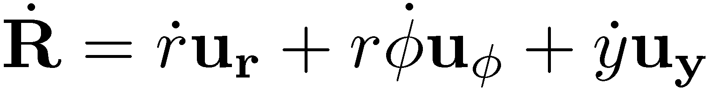
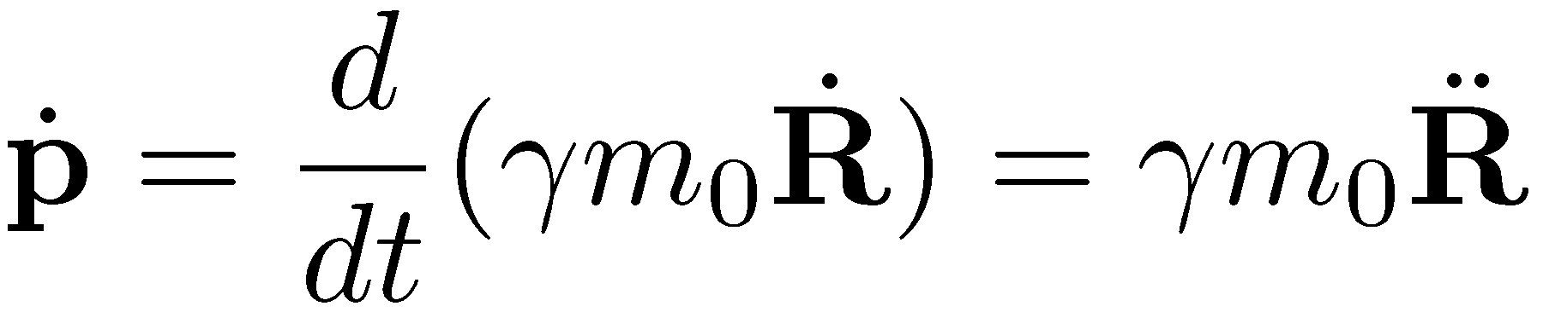
Rotating coordinate system
Consider a particle with charge q moving in the presence of transverse magnetic fields
Choose cylindrical coordinate system (r,φ,y), with r = x+ρ and φ = s/ρ
The radius vector is
For a small displacement dφ
y
Particle trajectory
r
R
θ
Ideal path
y
r
φ
ρ
Than the velocity is
And the acceleration
Recall that the momentum is

Slide 6
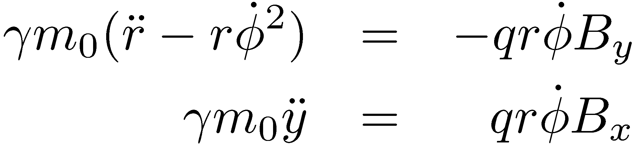
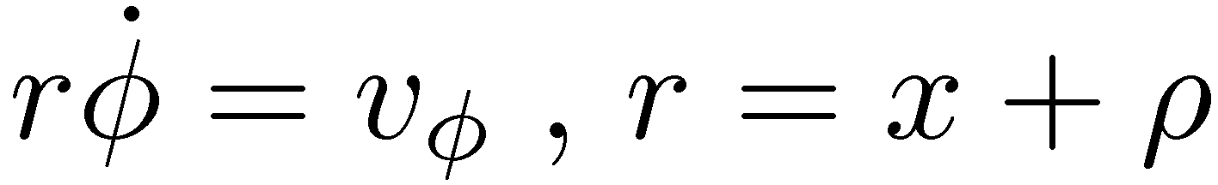
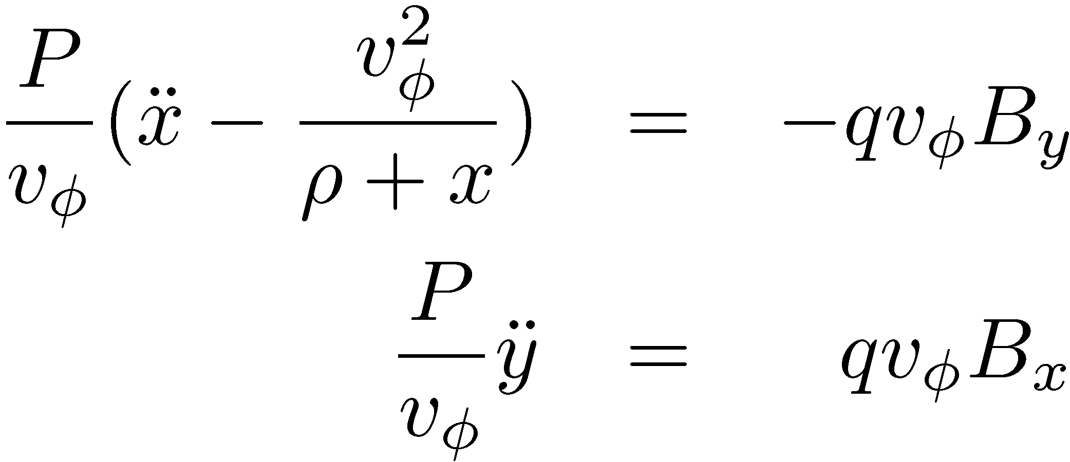
Equations of motion
Setting the electric field to zero and the magnetic field
The Lorentz equations become
Replacing the momentum with the adequate expression and splitting the equations for the r and y direction
Replace and as
The equations of motion in the new coordinates are

Slide 7
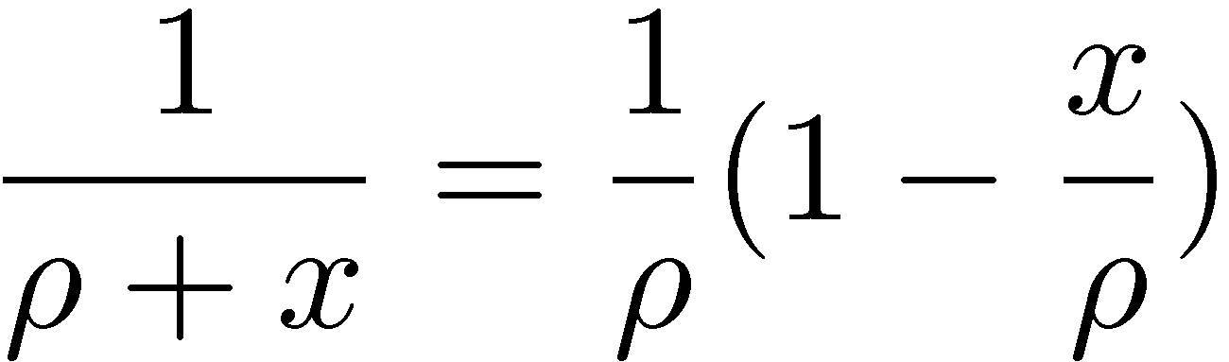
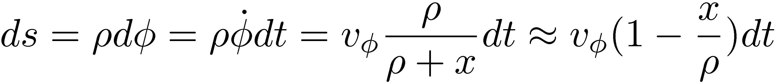
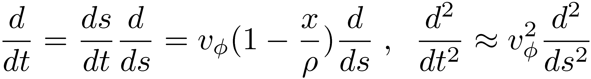
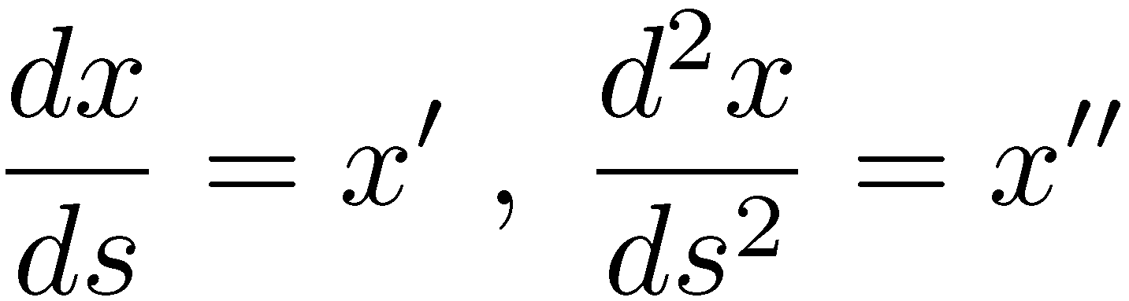
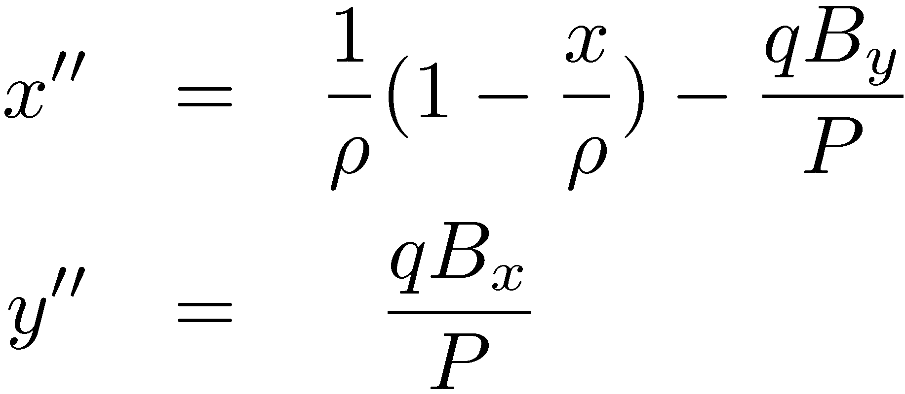
General equations of motion
Note that for x<<ρ
It is convenient to consider the arc length s as the independent variable
and
Denote
The general equations of motion are
Remark: Note that without the approximations, the equations are nonlinear and coupled!
The fields have to be defined

Slide 8
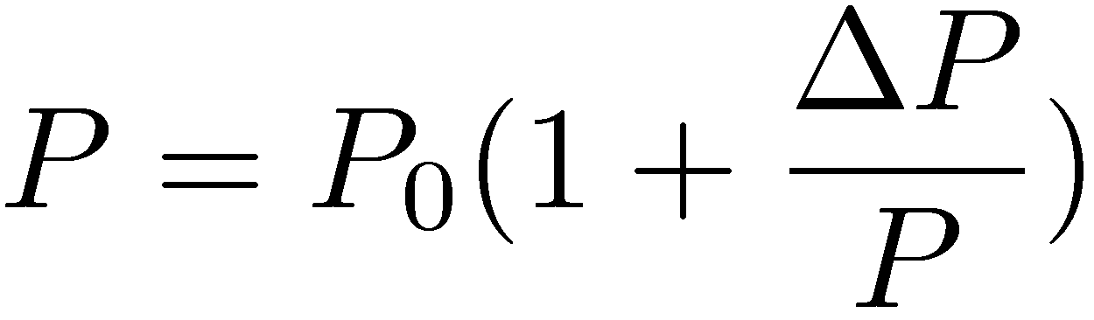
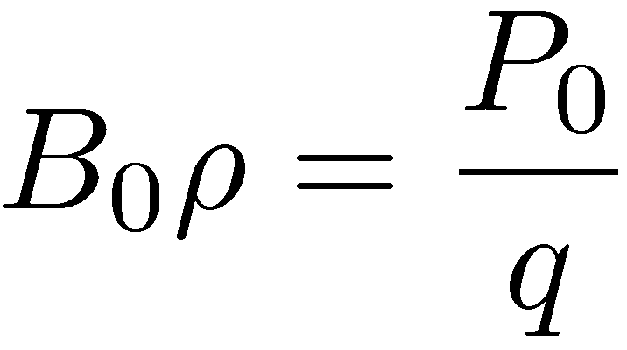
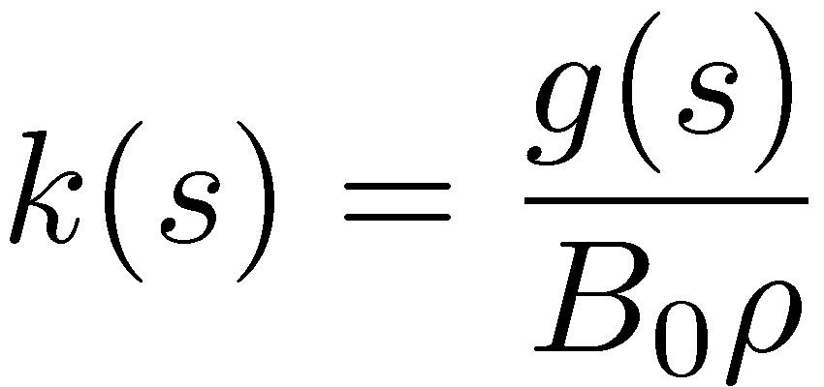
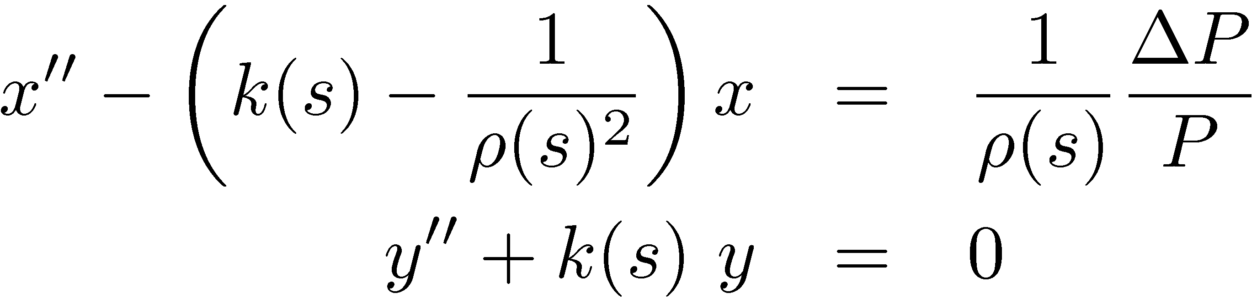
Equations of motion – Linear fields
Consider s-dependent fields from dipoles and normal quadrupoles
The total momentum can be written
With magnetic rigidity and normalized gradient the equations of motion are
Inhomogeneous equations with s-dependent coefficients
Note that the term 1/ρ² corresponds to the dipole week focusing
The term ΔP/(Pρ) represents off-momentum particles

Slide 9
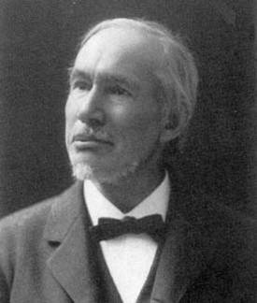
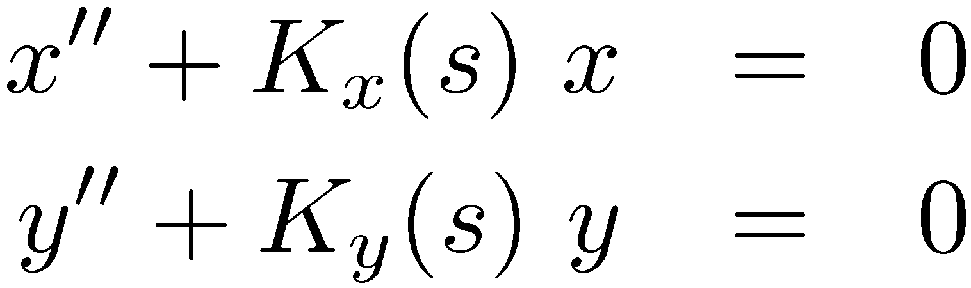
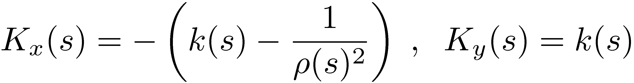
Hill’s equations
Solutions are combination of the ones from the homogeneous and inhomogeneous equations
Consider particles with the design momentum. The equations of motion become
with
Hill’s equations of linear transverse particle motion
Linear equations with s-dependent coefficients (harmonic oscillator with time dependent frequency)
In a ring (or in transport line with symmetries), coefficients are periodic
Not straightforward to derive analytical solutions for whole accelerator
George Hill

Slide 10
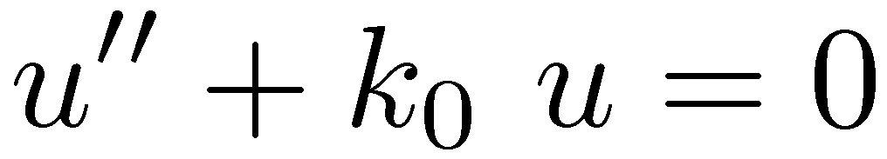
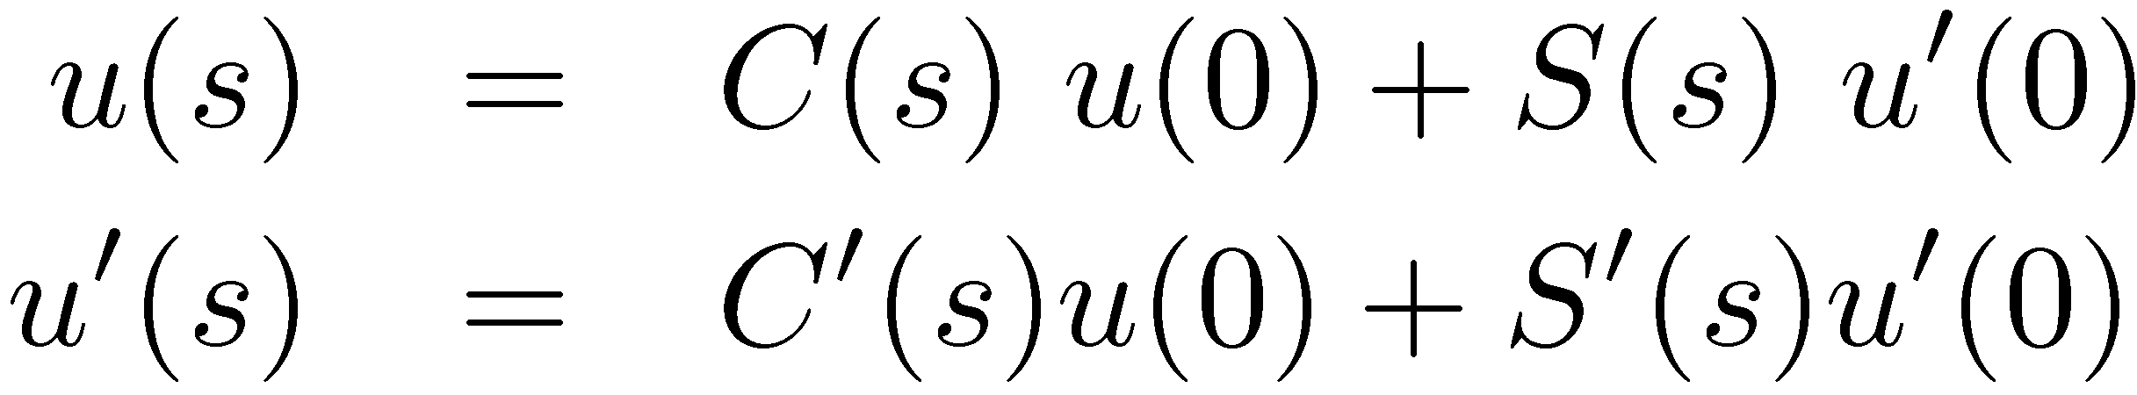
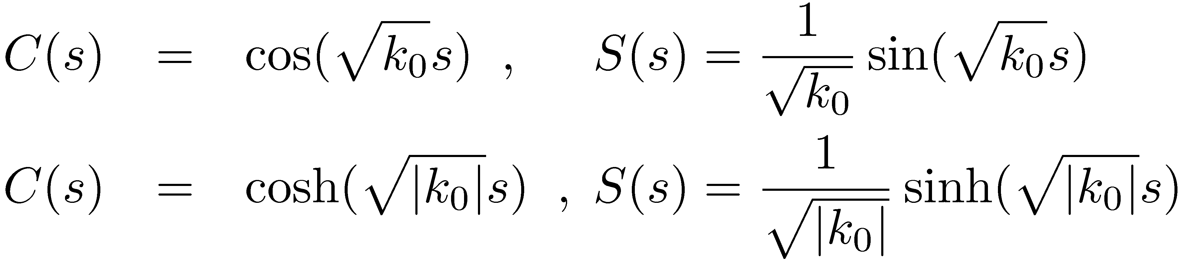
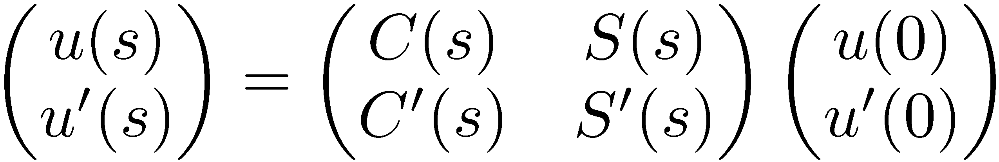
Harmonic oscillator – spring
Consider K(s) = k₀ = constant
Equations of harmonic oscillator with solution
with
for k₀ > 0
for k₀ < 0
u
u
Note that the solution can be written in matrix form

Slide 11
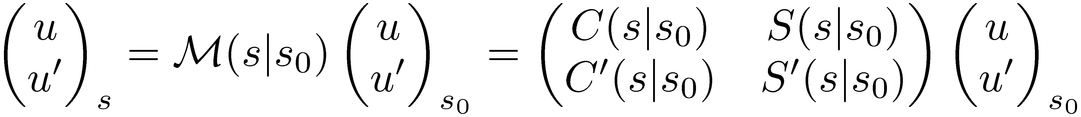
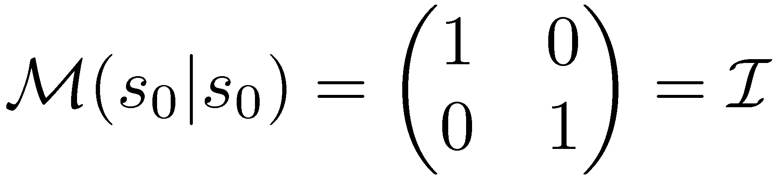
Matrix formalism
General transfer matrix from s₀ to s
Note that
which is always true for conservative systems
Note also that
The accelerator can be build by a series of matrix multiplications
S₁
S₂
S₃
…
S_{n-1}
from s₀ to s₁
S₀
S_{n}
from s₀ to s₂
from s₀ to s₃
from s₀ to s_{n}

Slide 12
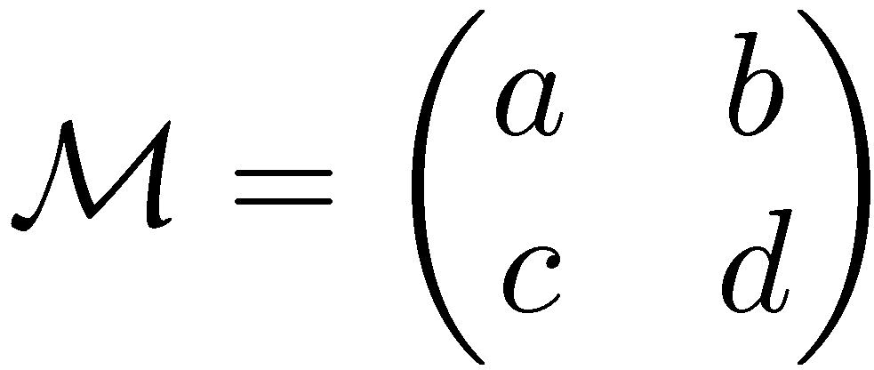
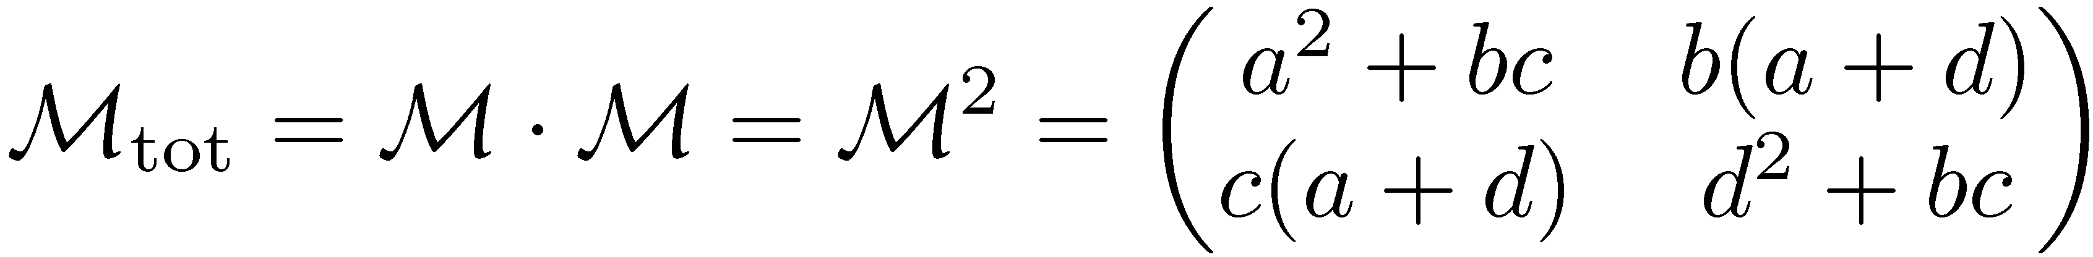
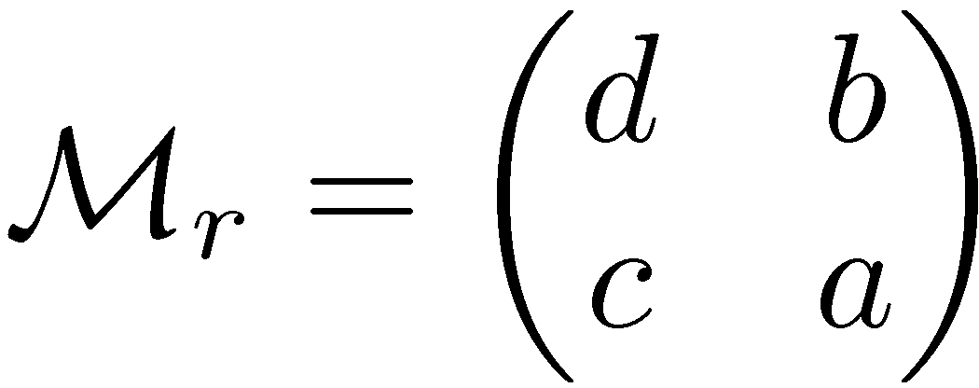
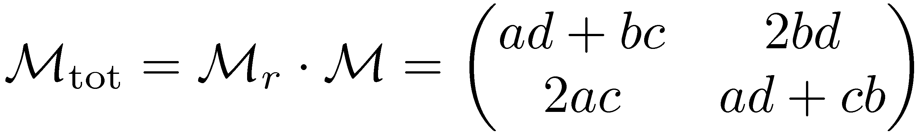
Symmetric lines
System with normal symmetry
S
System with mirror symmetry
S

Slide 13
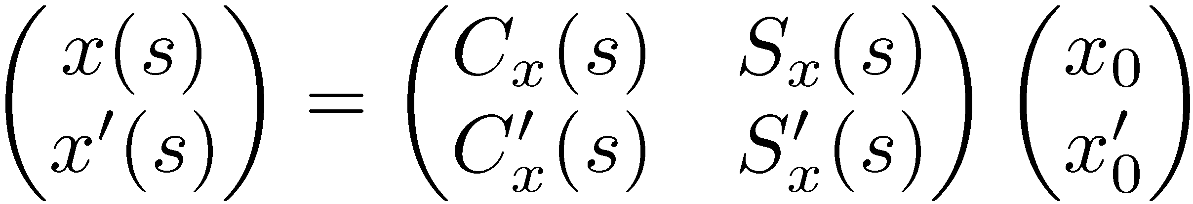
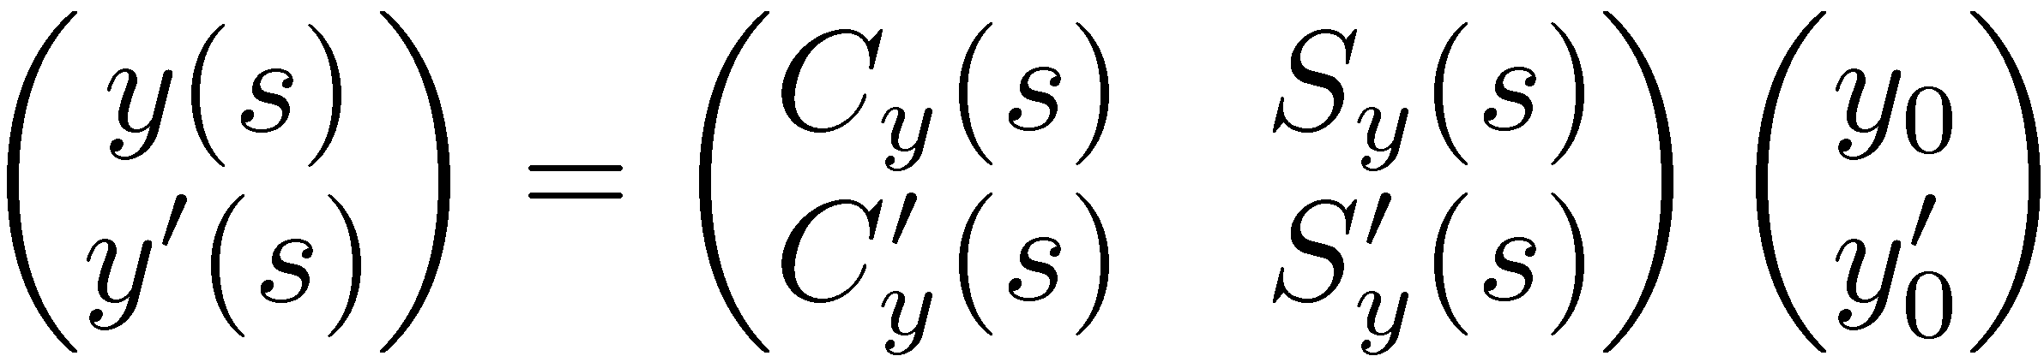
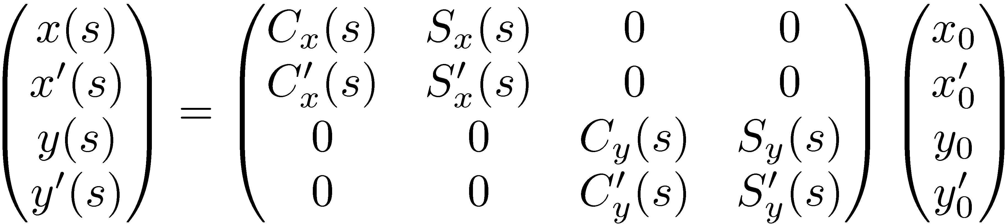
4x4 Matrices
Combine the matrices for each plane
to get a total 4x4 matrix
Uncoupled motion

Slide 14
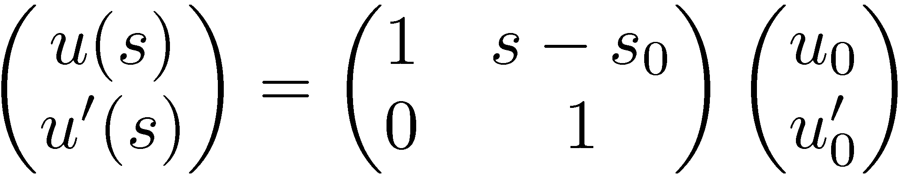
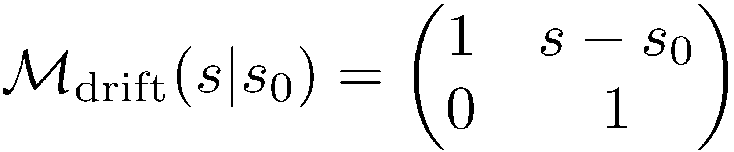
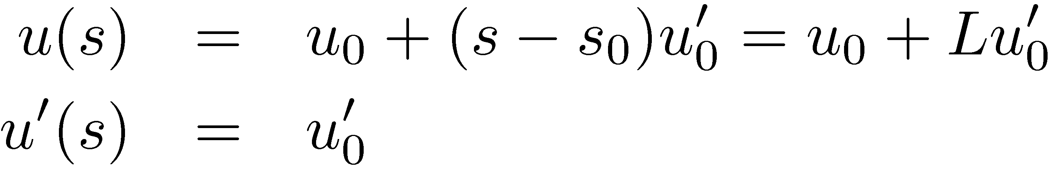
Transfer matrix of a drift
Consider a drift (no magnetic elements) of length L=s-s₀
Position changes if particle has a slope which remains unchanged.
L
After
u’
Before
u’⋅L
0
L
s
u
Real Space
Phase Space

Slide 15
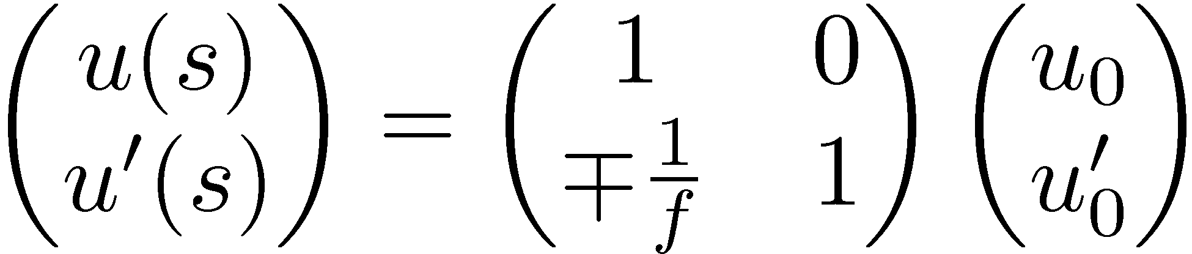
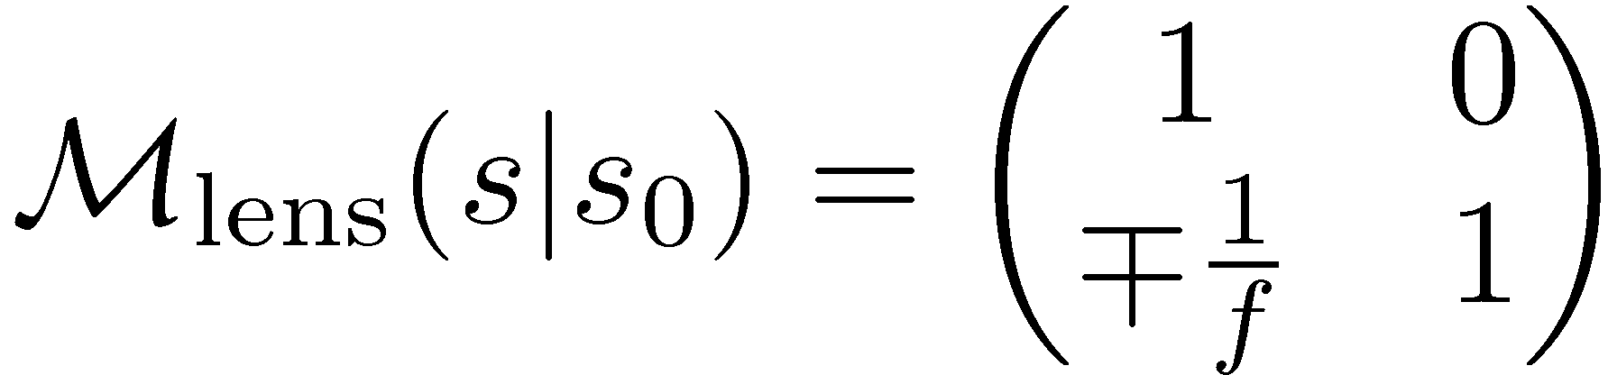
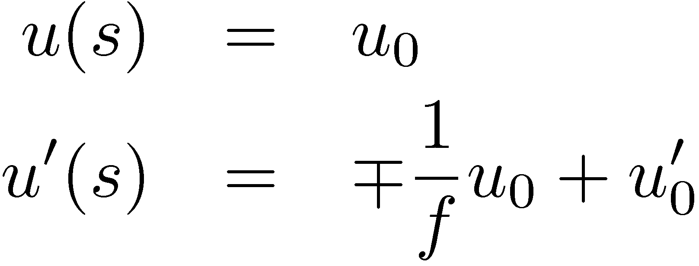
(De)focusing thin lens
Consider a lens with focal length ±f
Slope diminishes (focusing) or increases (defocusing) for positive position, which remains unchanged.
u’
u
Before
After
0
f
u’
After
u
Before
f
0

Slide 16
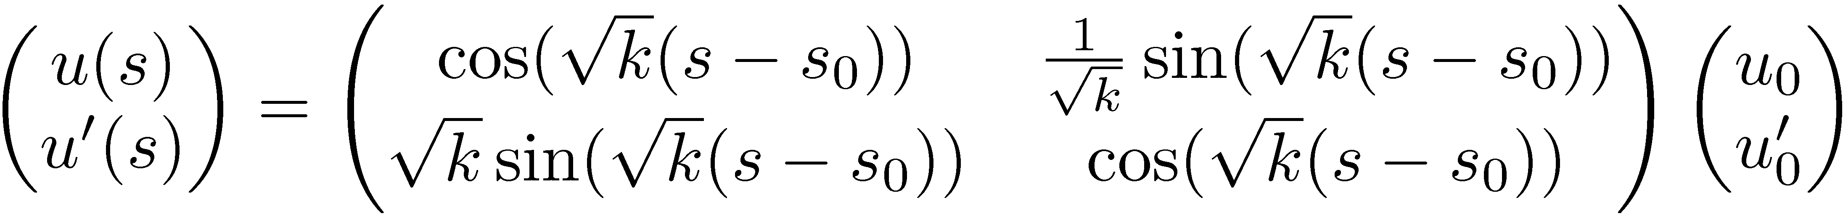
Quadrupole
Consider a quadrupole magnet of length L = s-s₀. The field is
with normalized quadrupole gradient (in m⁻²)
The transport through a quadrupole is
u’
u
0
L
s

Slide 17
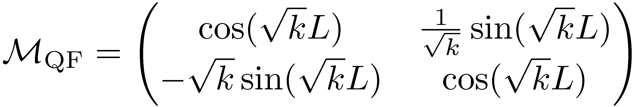
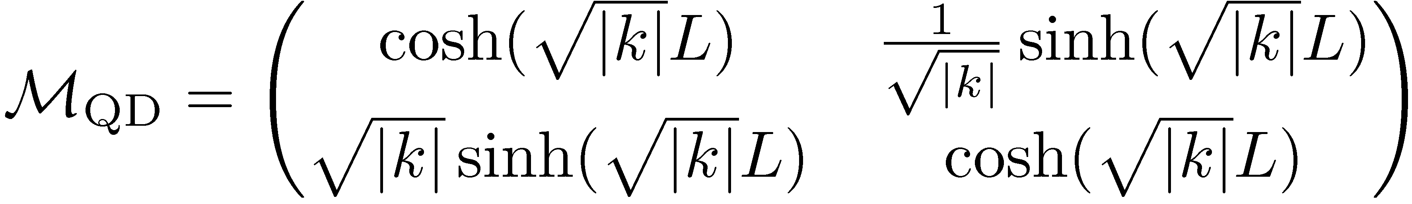
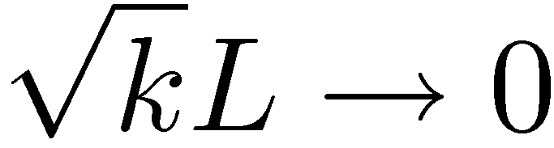

(De)focusing Quadrupoles
For a focusing quadrupole (k>0)
For a defocusing quadrupole (k<0)
By setting
Note that the sign of k or f is now absorbed inside the symbol
In the other plane, focusing becomes defocusing and vice versa

Slide 18
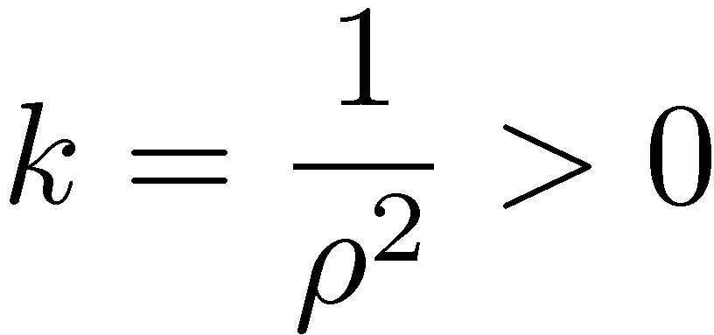
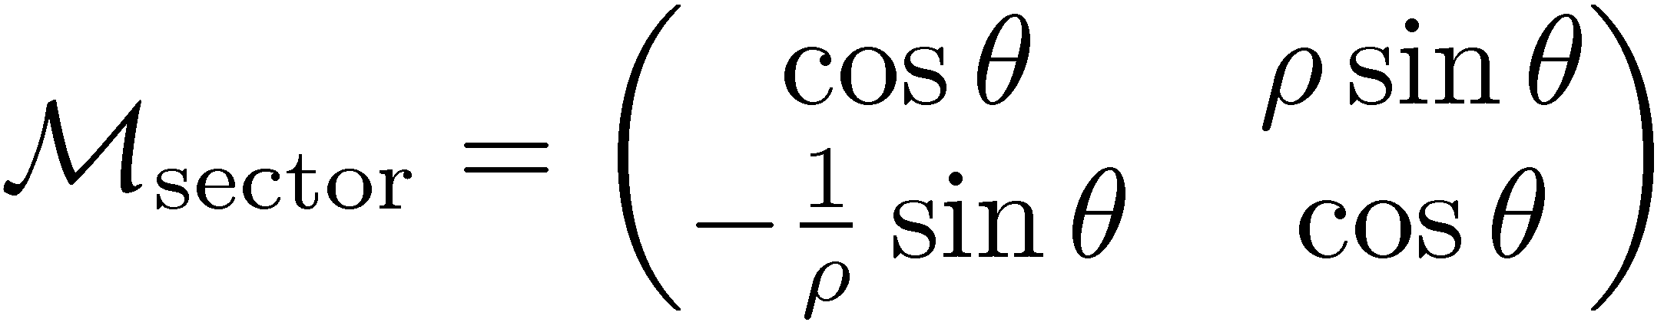
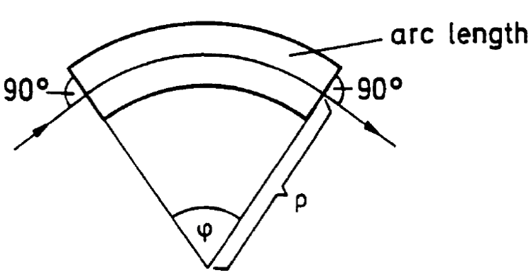
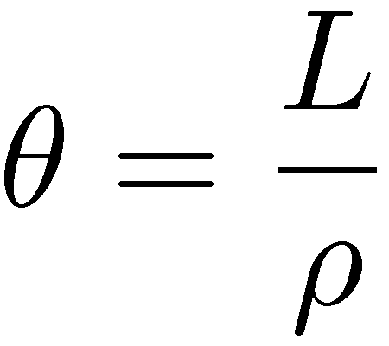
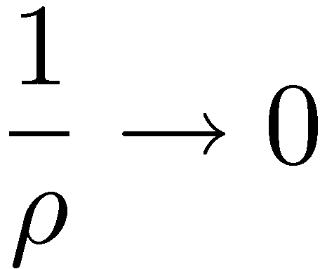

Sector Dipole
Consider a dipole of (arc) length L.
By setting in the focusing quadrupole matrix the transfer matrix for a sector dipole becomes
with a bending radius
In the non-deflecting plane and
This is a hard-edge model. In fact, there is some edge focusing in the vertical plane
Matrix generalized by adding gradient (synchrotron magnet)
L
θ

Slide 19
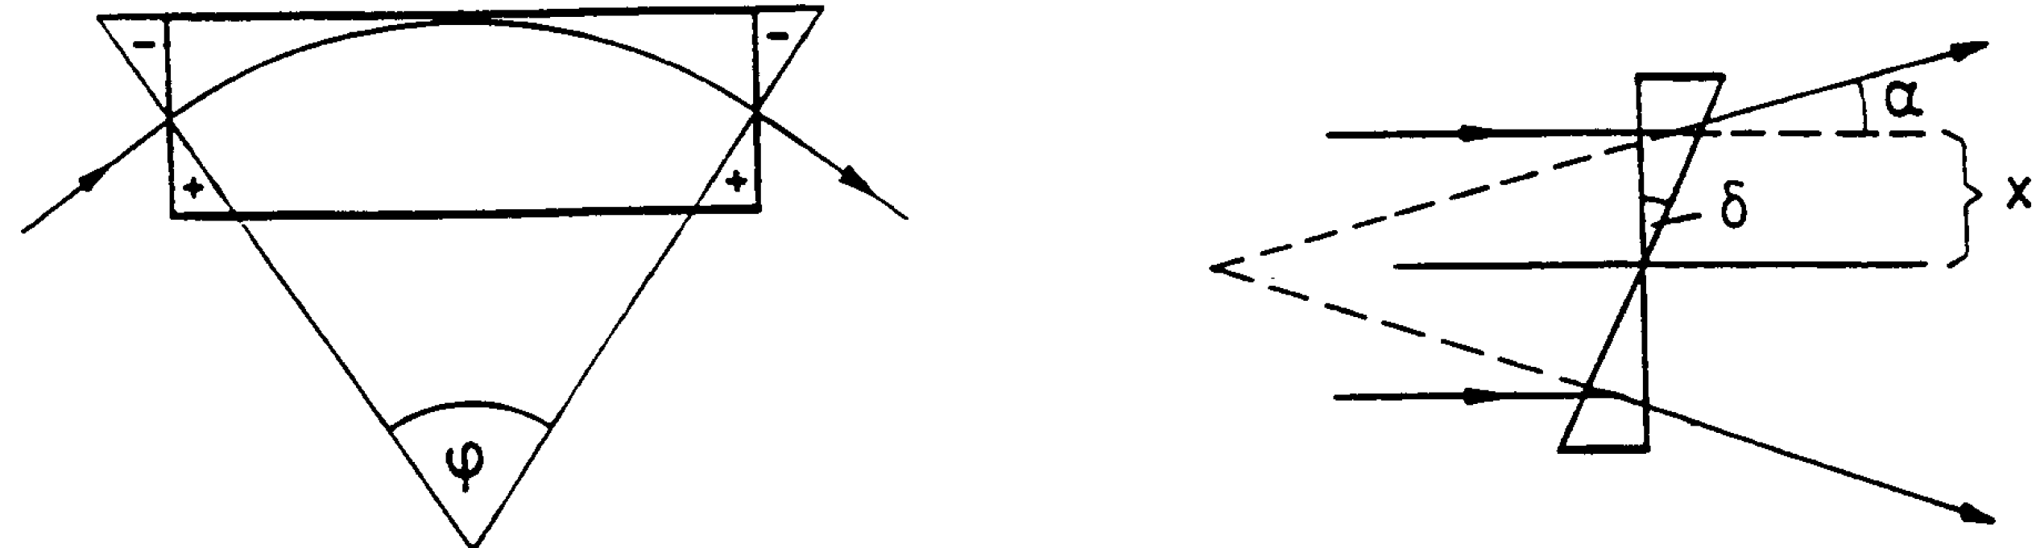
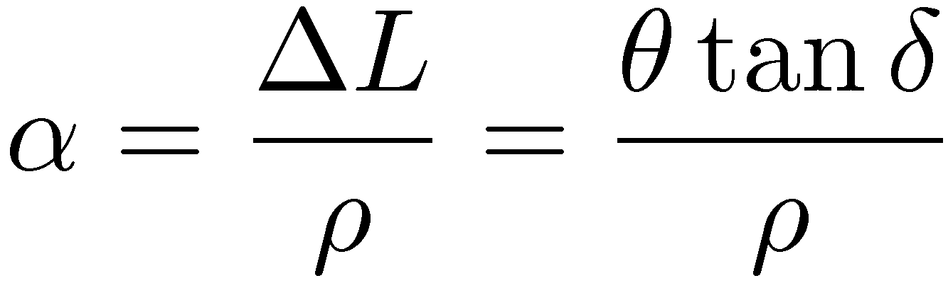




Rectangular Dipole
ΔL
θ
Consider a rectangular dipole with bending angle θ. At each edge of length ΔL, the deflecting angle is changed by
i.e., it acts as a thin defocusing lens with focal length
The transfer matrix is with
For θ<<1, δ=θ/2
In deflecting plane (like drift), in non-deflecting plane (like sector)

Slide 20



Quadrupole doublet
Consider a quadrupole doublet, i.e. two quadrupoles with focal lengths f₁ and f₂ separated by a distance L.
In thin lens approximation the transport matrix is
x
L
with the total focal length
Setting f₁ = - f₂ = f
Alternating gradient focusing seems overall focusing
This is only valid in thin lens approximation

Slide 21

FODO Cell
Consider defocusing quad “sandwiched” by two focusing quads with focal lengths ± f.
Symmetric transfer matrix from center to center of focusing quads
L
L
with the transfer matrices
The total transfer matrix is

Slide 22
Outline - part II
General solutions of Hill’s equations
  Floquet theory
Betatron functions
Transfer matrices revisited
  General and periodic cell
General transport of betatron functions
  Drift, beam waist
Normalized coordinates
Off-momentum particles
  Effect from dipoles and quadrupoles
  Dispersion equation
  3x3 transfer matrices

Slide 23

Solution of Betatron equations
Betatron equations are linear with periodic coefficients
Floquet theorem states that the solutions are
where w(s), ψ(s) are periodic with the same period
Note that solutions resemble the one of harmonic oscillator
Substitute solution in Betatron equations
0
0

Slide 24



Betatron functions
By multiplying with w the coefficient of sin
Integrate to get
Replace ψ’ in the coefficient of cos and obtain
Define the Betatron or Twiss or lattice functions (Courant-Snyder parameters)

Slide 25








Betatron motion
The on-momentum linear betatron motion of a particle is described by
with the twiss functions
the betatron phase
and the beta function is defined by the envelope equation
By differentiation, we have that the angle is

Slide 26












Courant-Snyder invariant
Eliminating the angles by the position and slope we define the Courant-Snyder invariant
This is an ellipse in phase space with area πε
The twiss functions have a geometric meaning
The beam envelope is
The beam divergence

Slide 27



General transfer matrix
From equation for position and angle we have
Expand the trigonometric formulas and set ψ(0)=0 to get the transfer matrix from location 0 to s
with
and the phase advance

Slide 28




Periodic transfer matrix
Consider a periodic cell of length C
The optics functions are
and the phase advance
The transfer matrix is
The cell matrix can be also written as
with and the Twiss matrix

Slide 29




Stability conditions
From the periodic transport matrix
and the following stability criterion
In a ring, the tune is defined from the 1-turn phase advance
i.e. number betatron oscillations per turn
From transfer matrix for a cell
we get

Slide 30



Transport of Betatron functions
For a general matrix between position 1 and 2
and the inverse
Equating the invariant at the two locations
and eliminating the transverse positions and angles

Slide 31



Example I: Drift
Consider a drift with length s
The transfer matrix is
The betatron transport matrix is
from which
γ
β
α
s

Slide 32






Simplified method for betatron transport
Consider the beta matrix the matrix
and its transpose
It can be shown that
Application in the case of the drift
and

Slide 33





Example II: Beam waist
For beam waist α=0 and occurs at s = α₀/γ₀
Beta function grows quadratically and is minimum in waist
γ
β
α
s
waist
The beta at the waste for having beta minimum
in the middle of a drift with length L is
The phase advance of a drift is
which is π/2 when . Thus, for a drift

Slide 34



Effect of dipole on off-momentum particles
Up to now all particles had the same momentum P₀
What happens for off-momentum particles, i.e. particles with momentum P₀+ΔP?
Consider a dipole with field B and bending radius ρ
Recall that the magnetic rigidity is and for off-momentum particles
Considering the effective length of the dipole unchanged
Off-momentum particles get different deflection (different orbit)
P₀+ΔP
P₀
ρ+δρ
ρ
θ

Slide 35



Off-momentum particles and quadrupoles
Consider a quadrupole with gradient G
Recall that the normalized gradient is
and for off-momentum particles
Off-momentum particle gets different focusing
This is equivalent to the effect of optical lenses on light of different wavelengths
P₀+ΔP
P₀

Slide 36





Dispersion equation
Consider the equations of motion for off-momentum particles
The solution is a sum of the homogeneous equation (on-momentum) and the inhomogeneous (off-momentum)
In that way, the equations of motion are split in two parts
The dispersion function can be defined as
The dispersion equation is

Slide 37




Dispersion solution for a bend
Simple solution by considering motion through a sector dipole with constant bending radius
The dispersion equation becomes
The solution of the homogeneous is harmonic with frequency
A particular solution for the inhomogeneous is
and we get by replacing
Setting D(0) = D₀ and D’(0) = D₀’, the solutions for dispersion are

Slide 38






General dispersion solution
General solution possible with perturbation theory and use of Green functions
For a general matrix the solution is
One can verify that this solution indeed satisfies the differential equation of the dispersion (and the sector bend)
The general Betatron solutions can
be obtained by 3X3 transfer
matrices including dispersion
Recalling that
and

Slide 39



3x3 transfer matrices - Drift, quad and sector bend
For drifts and quadrupoles which do not create dispersion the 3x3 transfer matrices are just
For the deflecting plane of a sector bend we have seen that the matrix is
and in the non-deflecting plane is just a drift.

Slide 40




3x3 transfer matrices - Synchrotron magnet
Synchrotron magnets have focusing and bending included in their body.
From the solution of the sector bend, by replacing 1/ρ with
For K>0
For K<0
with

Slide 41


3x3 transfer matrices - Rectangular magnet
The end field of a rectangular magnet is simply the one of a quadrupole. The transfer matrix for the edges is
The transfer matrix for the body of the magnet is like for the sector bend
The total transfer matrix is

Slide 42

Chromatic closed orbit
Off-momentum particles are not oscillating around design orbit, but around chromatic closed orbit
Distance from the design orbit depends linearly with momentum spread and dispersion
Design orbit
Design orbit
Chromatic close orbit
On-momentum particle trajectory
Off-momentum particle trajectory

Slide 43
Outline – part III
Periodic lattices in circular accelerators
  Periodic solutions for beta function and dispersion
  Symmetric solution
FODO cell
  Betatron functions and phase advances
  Optimum betatron functions
  General FODO cell and stability
  Solution for dispersion
  Dispersion supressors
General periodic solutions for the dispersion
Tune and Working point
Matching the optics

Slide 44


Periodic solutions
Consider two points s₀ and s₁ for which the magnetic structure is repeated.
The optical function follow periodicity conditions
The beta matrix at this point is
Consider the transfer matrix from s₀ to s₁
The solution for the optics functions is
with the condition

Slide 45


Periodic solutions for dispersion
Consider the 3x3 matrix for propagating dispersion between s₀ and s₁
Solve for the dispersion and its derivative to get
with the conditions

Slide 46






Symmetric solutions
Consider two points s₀ and s₁ for which the lattice is mirror symmetric
The optical function follow periodicity conditions
The beta matrices at s₀ and s₁ are
Considering the transfer matrix between s₀ and s₁
The solution for the optics functions is
with the condition

Slide 47


Symmetric solutions for dispersion
Consider the 3x3 matrix for propagating dispersion between s₀ and s₁
Solve for the dispersion in the two locations
Imposing certain values for beta and dispersion, quadrupoles can be adjusted in order to get a solution

Slide 48





Periodic lattices’ stability criterion revisited
Consider a general periodic structure of length 2L which contains N cells. The transfer matrix can be written as
The periodic structure can be expressed as
with
Note that because
Note also that
By using de Moivre’s formula
We have the following general stability criterion

Slide 49
FODO Cell
FODO is the simplest basic structure
  Half focusing quadrupole (F) + Drift (O) + Defocusing quadrupole (D) + Drift (O)
  Dipoles can be added in drifts for bending
  Periodic lattice with mirror symmetry in the center
  Cell period from center to center of focusing quadrupole
  The most common structure is accelerators
s
QF_{1/2}
QD
QF_{1/2}
L
L
FODO period

Slide 50



FODO transfer matrix
Restrict study in thin lens approximation for simplicity
FODO symmetric from any point to any point separated by 2L
Useful to start and end at center of QF or QD, due to mirror symmetry
The transfer matrix is
and we have
where we set for a symmetric FODO
Note that diagonal elements are equal due to mirror symmetry

Slide 51




Betatron function for a FODO
By using the formulas for the symmetric optics functions
we get the beta on the center of the focusing quad
Starting in the center of the defocusing quad (simply setting f to -f)
Solutions for both horizontal and vertical plane
  In the center of QF
  In the center of QD
Knowing the beta functions at one point, their evolution can be determined through the FODO cell

Slide 52

Example of Betatron functions evolution
Betatron functions evolution in a FODO cell

Slide 53




Phase advance for a FODO
For a symmetric cell, the transfer matrix can be written as
So the phase advance is
This imposes the condition which means that the focal length should be smaller than the distance between quads
For , the beta function becomes infinite, so in between there should be a minimum

Slide 54




Optimum betatron functions in a FODO
Start from the solution for beta in the focusing quad
Take the derivative to vanish
The solution for the focusing strength is
So the optimum phase advance is
This solution however cannot minimize the betatron function in both planes
It is good only for flat beams

Slide 55






Optimum betatron functions for round beams
Consider a round beam
The maximum beam acceptance is obtained by minimizing quadratic sum of the envelopes
The minimum is determined by
The minimum is reached for
and the optimum phase is
The betatron functions are
In order to fit an aperture of radius R
The maximum emittance is

Slide 56


Scaling of betatron functions in a FODO
Scaling of the betatron functions with respect to the optimum values
Scaling is independent of L
It only depends on the ratio of the focal length and L
The distance can be adjusted as a free parameter
As the maximum beta functions are scaled linearly with L
The maximum beam size in a FODO cell scales like with
β⁺/β⁺_{opt}
β⁻/β⁻_{opt}

Slide 57

Periodic lattices’ stability criterion revisited
Consider a general periodic structure of length 2L which contains N cells. The transfer matrix can be written as
The periodic structure can be expressed as
with
Note that because
Note also that
By using de Moivre’s formula
We have the following general stability criterion

Slide 58



General FODO cell
So far considered transformation matrix for equal strength quadrupoles
The general transformation matrix for a FODO cell
with
Multiplication with the reverse matrix
gives

Slide 59







Stability for a general FODO cell
Setting we have hat the transfer
matrix for a half cell is
Equating this with the betatron transfer matrix we have
The limits of the stable region give a necktie

Slide 60


3X3 FODO cell matrix
Insert a sector dipole in between the quads and consider θ=L/ρ<<1
Now the transfer matrix is
which gives
and after multiplication

Slide 61



Dispersion in a FODO cell
Consider mirror symmetry conditions, i.e. the dispersion derivative vanishes in the middle of quads
Solving for the dispersion in the entrance and exit
We choose an optimum reference lattice where
and the ratio

Slide 62


Dispersion suppressors
Dispersion has to be eliminated in special areas like injection, extraction or interaction points (orbit independent to momentum spread)
Use dispersion suppressors
Two methods for suppressing dispersion
  Eliminate two dipoles in a FODO cell (missing dipole)
  Set last dipoles with
  different bending angles
  For equal bending angle
  dipoles the FODO phase
  advance should be equal
  to π/2

Slide 63









General solution for the dispersion
Introduce Floquet variables
The Hill’s equations are written
The solutions are the ones of an harmonic oscillator
For the dispersion solution , the inhomogeneous equation in Floquet variables is written
This is a forced harmonic oscillator with solution
Note the resonance conditions for integer tunes!!!

Slide 64


Tune and working point
In a ring, the tune is defined from the 1-turn phase advance
i.e. number betatron oscillations per turn
Taking the average of the betatron tune around the ring we have in smooth approximation
Extremely useful formula for deriving scaling laws
The position of the tunes in a diagram of horizontal versus vertical tune is called a working point
The tunes are imposed by the choice of the quadrupole strengths
One should try to avoid resonance conditions

Slide 65

Example: SNS Ring Tune Space
Tunability: 1 unit in horizontal, 3 units in vertical (2 units due to bump/chicane perturbation)
Structural resonances (up to 4th order)
All other resonances (up to 3rd order)
Working points considered
  (6.30,5.80) - Old
  (6.23,5.24)
  (6.23,6.20) - Nominal
  (6.40,6.30) - Alternative

Slide 66


Matching the optics
Optical function at the entrance and end of accelerator may be fixed (pre-injector, or experiment upstream)
Evolution of optical functions determined by magnets through transport matrices
Requirements for aperture constrain optics functions all along the accelerator
The procedure for choosing the quadrupole strengths in order to achieve all optics function constraints is called matching of beam optics
Solution is given by numerical simulations with dedicated programs (MAD, TRANSPORT, SAD, BETA, BEAMOPTICS) through multi-variable minimization algorithms
magnet structure
k₁ k₂ k₃ k₄ k₅ … k_{m}

Slide 67

Matching example – the SNS ring
First find the strengths of the two arc quadrupole families to get an horizontal phase advance of 2π and using the vertical phase advance as a parameter
Then match the straight section with arc by using the two doublet quadrupole families and the matching quad at the end of the arc in order to get the correct tune without exceeding the maximum beta function constraints
Retune arc quads to get correct tunes
Always keep beta, dispersion within acceptance range and quadrupole strength below design values

Slide 68





ESRF storage ring lattice upgrade
Purpose to minimize emittance at the insertion device (increase brilliance) by imposing specific β, α, D and D’ values at the entrance of the dipole
Usually need to create achromat (dispersion equal to 0) in the straight section (Double Bend Achromat – DBA, Triple Bend Achromat – TBA,…)
Try to minimize variation of beta function in the cell by tuning quadrupoles accordingly

Slide 69
LHC lattice examples
FODO arc with 3+3 super-conducting bending magnets and 2 quadrupoles in between
Beta functions between 30 and 180m
Collision points creating beam waists with betas of 0.5m using super-conducting quadrupoles in triplets
Huge beta functions on triplets

